Slide 1


Tim Hines, CMO, AmTrav
Gen Y & Gen Y Influencers
How to bridge the business travel generational gap

Slide 2
The Generations Defined
#GENY #GENZ #OKBOOMER
@TNHINES

Slide 3
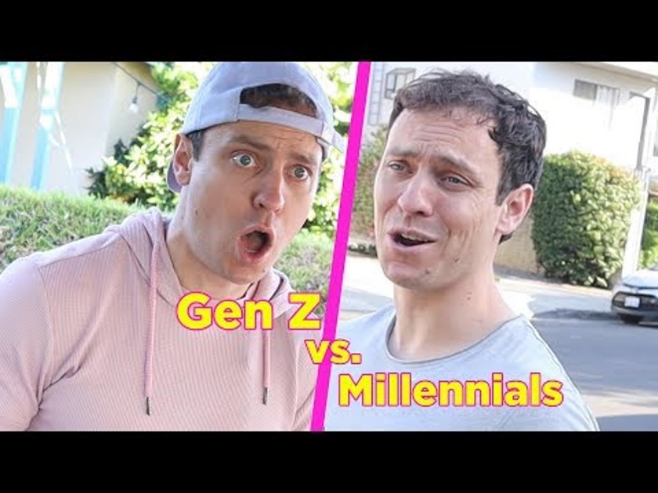

Slide 4
The Generations Defined
Z: Born ‘97-’12
Y: Born ‘81-’96
X: Born ‘65-’80
B: Born ‘46-’64
S: Born ‘28-’45
1920
1940
1960
1980
2000
2020

Slide 5
Who is Gen Y? The Millennials
Pioneers of the digital world (natives)
Highly approval-seeking
Leaders for social good
Super-preneurs
The most educated generation in history
Mountains of student loan debt
Struggles for middle class
First cord-cutters

Slide 6
Who is Gen Z? The Centennials
The largest generation EVER!
Uber visual… video > articles
Don’t know a world without the internet
Cause and community-driven
Influenced by influencers - created an industry!
Demand immediacy and personalization
Mobile is EVERYTHING

Slide 7
How They Stack Up
Gen Y
Gen Z
Millennials, Gen Me, Gen We
Born 1980-1996
Raised by Boomers
1.9b global / 80m U.S.
50% of workforce today
Pioneered digital
iGen, Post-Mills, Centennials
Born 1997-2012 / 15
Raised by Gen X
2.52b global / 90m U.S.
27% of workforce by 2025
Born in digital

Slide 8
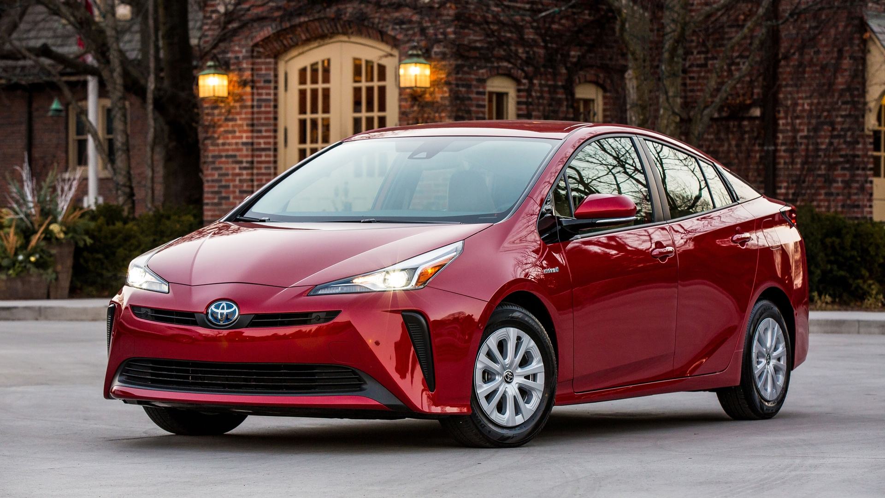
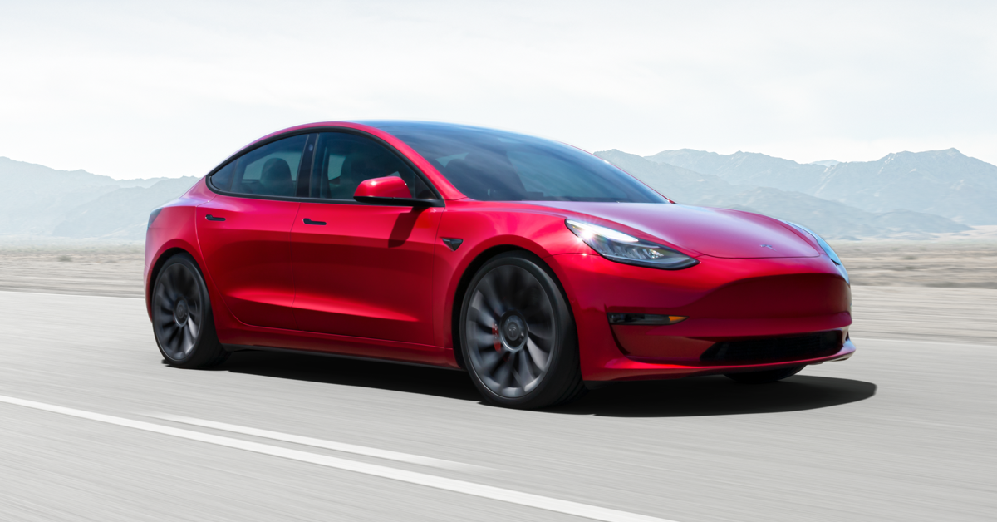
How They Stack Up
Prius
vs.
Tesla

Slide 9
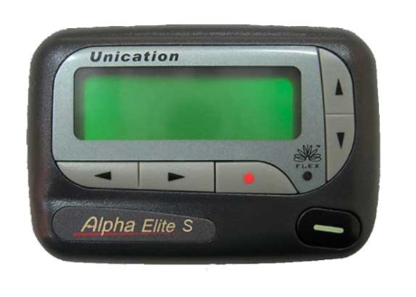

How They Stack Up
Pager
vs.
iPhone

Slide 10
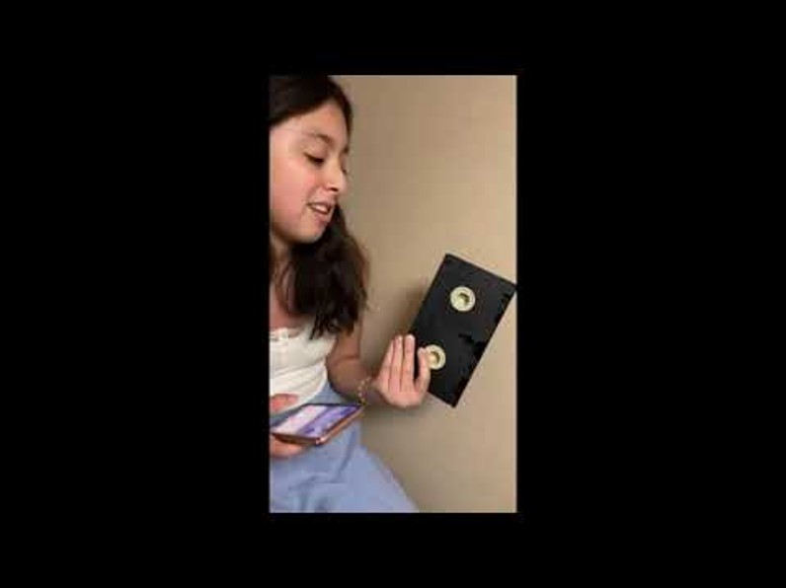

Slide 11
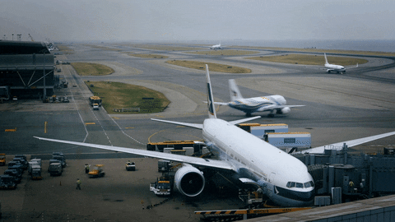
THEIR INFLUENCES ON TRAVEL

Slide 12




Travel Profile
EMBRACE
CHANGE
Tech savvy
Socially active
Expect Customization
More comfortable with travel

Slide 13
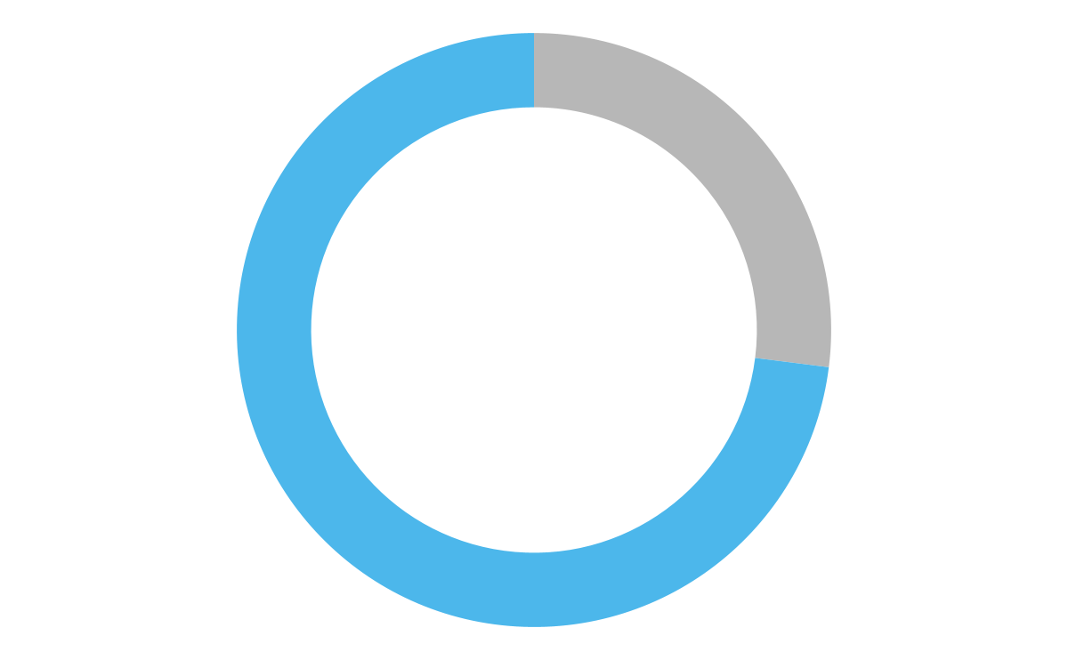

73%

Slide 14

50%
Of all flights booked

Slide 15

39%
Won’t take the gig

Slide 16
How They Use Mobile
Managing & Reviewing
Connecting with Friends
Searching & Booking
Customer Service

Slide 17
Reviews On Reviews
80%

Slide 18
#BLEISURE

Slide 19
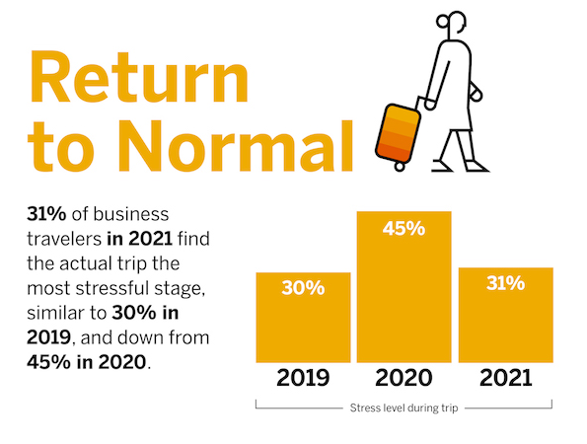
Concur Return to Travel Survey

Slide 20
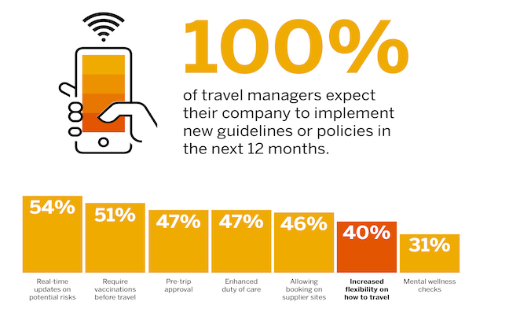
Concur Return to Travel Survey

Slide 21
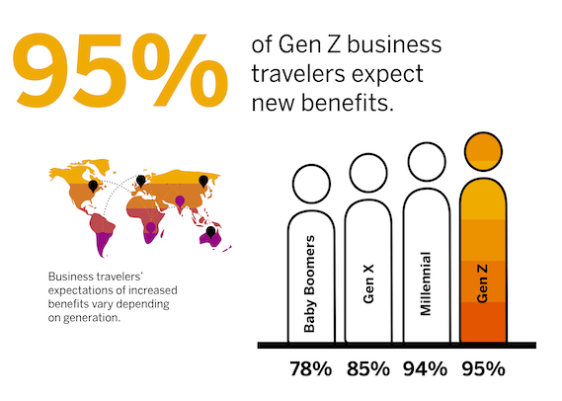
Concur Return to Travel Survey

Slide 22

Personalization is Everything
Self Service Autonomy
Adjust on the Fly
Leverage Social Tools
Chat/Text > Voice
Bite Sized Pieces

Slide 23
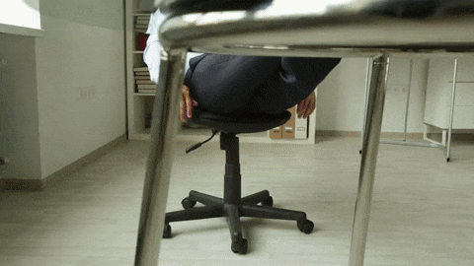
THE WAY THEY WORK

Slide 24


Slide 25
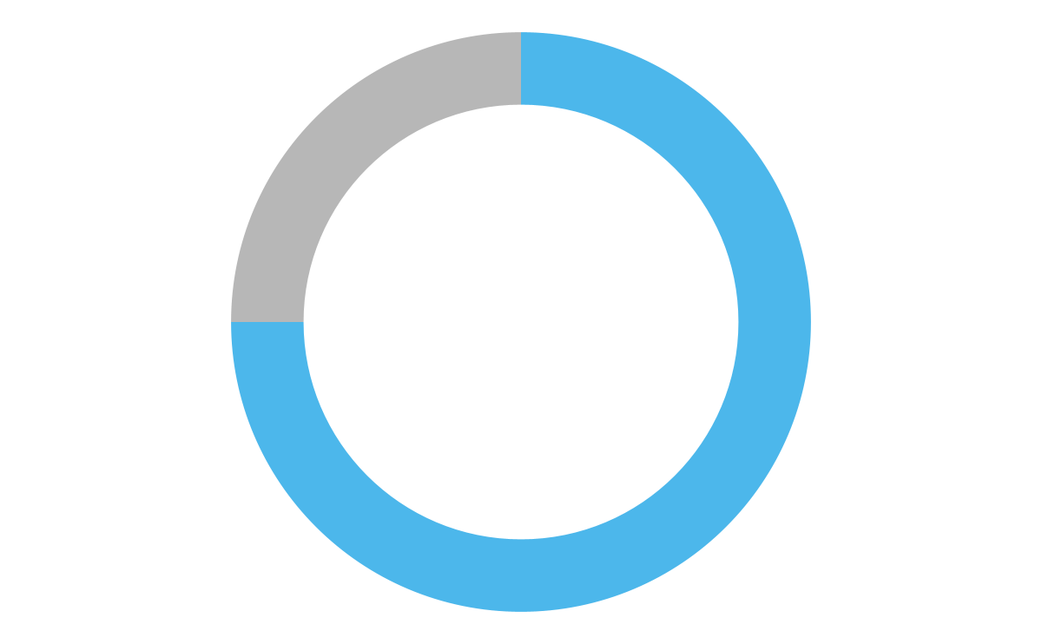

75%

Slide 26

36%

Slide 27
50%
#GREATRESIGNATION

Slide 28


92%

Slide 29
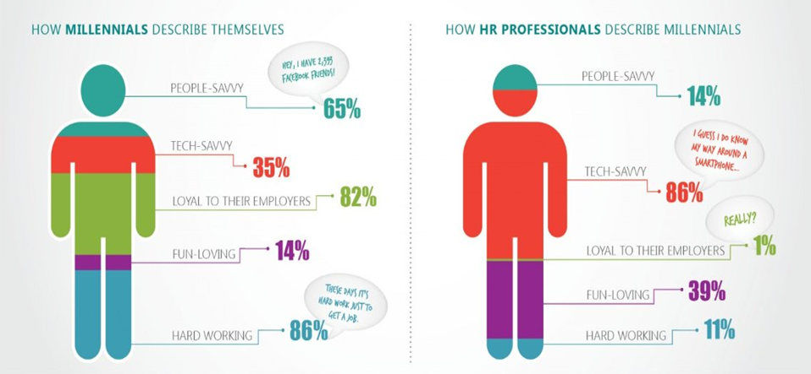
The Great Divide

Slide 30
Who is Gen A? The Alphas
The first to be born wholly within the 21st century
Oldest are turning 10 next year
Best educated
Wealthiest
Most tech-immersed
Spend some or all their time without both parents

Slide 31

Let’s Win Them Over!
Be brief, informative & clear
Offer constructive validation - no trophies!
End-to-end personalization
Embrace technology
Know your limits & set real boundaries

Slide 32
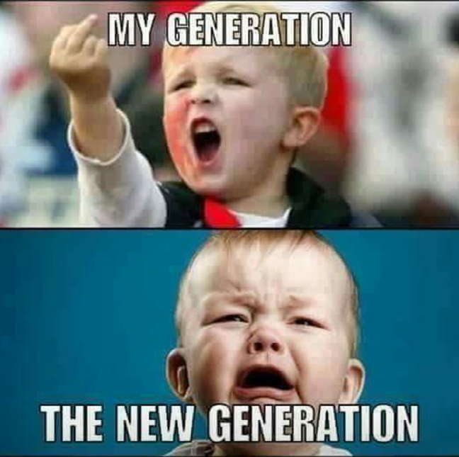

Slide 33
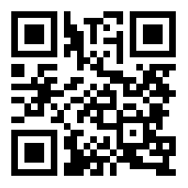
Thanks!
@TNHINES • TNHINES.COM

Slide 34
Before you leave
Give us Your Feedback -
It’s in the App!
1- Click on « Schedule »
2- Find and add your session
3- Move to the bottom
4- Take the survey ☺
Join us to continue this conversation!
« Meet the experts »
Re:Imagine area in the Expo
14:00 – 14:30
Table 7

Slide 35
thank you for attending :)

