Slide 1


Driving sustainability in your travel program; a 3-step approach

Slide 2
Ciska Teunis, Sustainability Practice Line Lead EMEA, Amex GBT Global Business Consulting
Mark Cuschieri, Executive Director,
Global Head of Travel, UBS.
Annelies Glandorf, Programme Experience Manager,
Global Corporate Travel, Shell International B.V.

Slide 3
Live poll question
What do you find is the most challenging aspect of addressing sustainability?
Taking the first step.
Identifying opportunities to reduce emissions.
Quantifying emission reduction opportunities.
I have not started addressing sustainability.
No challenges right now.
Go to www.slido.com
Enter poll #1634999

Slide 4
1. Determine your baseline year
You’ll build your carbon reduction plans on
emissions in this year.
2018
2019
2020
2021

Slide 5
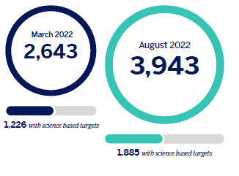
2. Define emission reduction target
Set the direction for your journey.
With the target, you can:
Define overall size of the reduction you need to make.
Calculate the annual reduction you need to achieve.
Plan a roadmap to realise the reductions.
Companies committing to act on
emissions reductions rises 49%
in 8 months.
Source: Science Based Targets

Slide 6
Live poll question
Has your company committed to a net zero carbon reduction target?
Yes.
Not yet, but we are setting a target.
No, but we plan to set a target within the next 6 months.
No, and we have no plans.
Go to www.slido.com
Enter poll #1634999
Notes:
Discuss the responses with Mark and invite him to give the UBS perspective on this

Slide 7
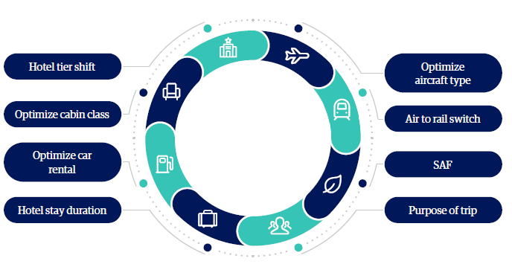
3. Assess your opportunities to drive reductions
If you don’t know where you can achieve emissions reductions, you’ll find it difficult to drive your sustainability goals.
A number of travel levers are available today that can help you
reduce emissions from travel. Which are the right ones for your
program (and your travellers)?

Slide 8
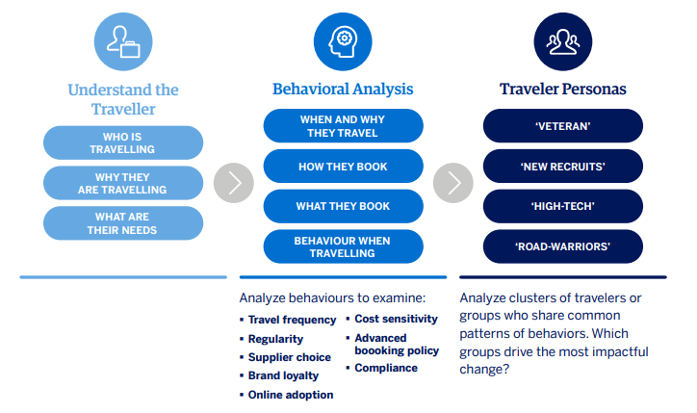
“Make it stick” with travellers
Designing behavioural interventions
To achieve lasting emissions reductions, you need:
Purposeful interventions.
Actionable emissions data.
Behavioural science approaches can help you design
purposeful interventions that are meaningful for your
travellers.

Slide 9

Key takeaways
Determine a baseline year and your preferred carbon calculation methodology.
Define your reduction target.
Assess and understand your reduction opportunities (and limitations!).
Make it stick
Get started! And remember - this is a marathon, not a sprint!

Slide 10
Live poll question
What’s your sustainability priority for 2023?
OPTIONS TO COME
Go to www.slido.com
Enter poll #1634999
Notes:
Discuss the responses with Mark and invite him to give the UBS perspective on this

Slide 11
Before you leave
Give us Your Feedback -
It’s in the App!
1- Click on « Schedule »
2- Find and add your session
3- Move to the bottom
4- Take the survey ☺
Join us to continue this conversation!
« Meet to the experts »
Re:Imagine area in the Expo
14:00 – 14:30
Table 9

Slide 12
thank you for attending :)

