Slide 1


Peter Grover, MD Europe, TRIPBAM
Jake Seage, Head of Sales, STAY Worldwide
Cecile Berehouc , Sales Manager , Adagio City
Emma Lamb, Global Travel Safety, Mitie@meta
From Duty of Care to Duty to Care in Accommodations

Slide 2
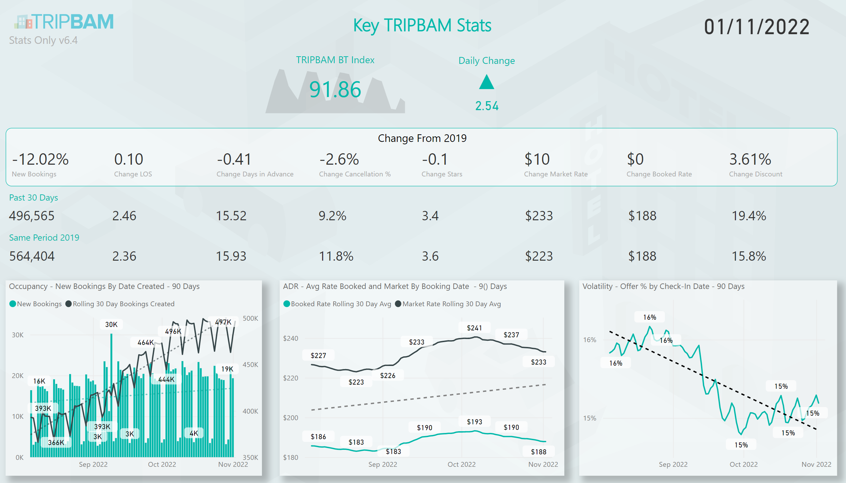
TRIPBAM Global Snapshot
Offer rate currently at 15%
Globally volume over 85% recovered (like for like)
Rates still above 2019
Discounts look higher than ‘19
Reduction in cancellations
Other areas stabilising

Slide 3
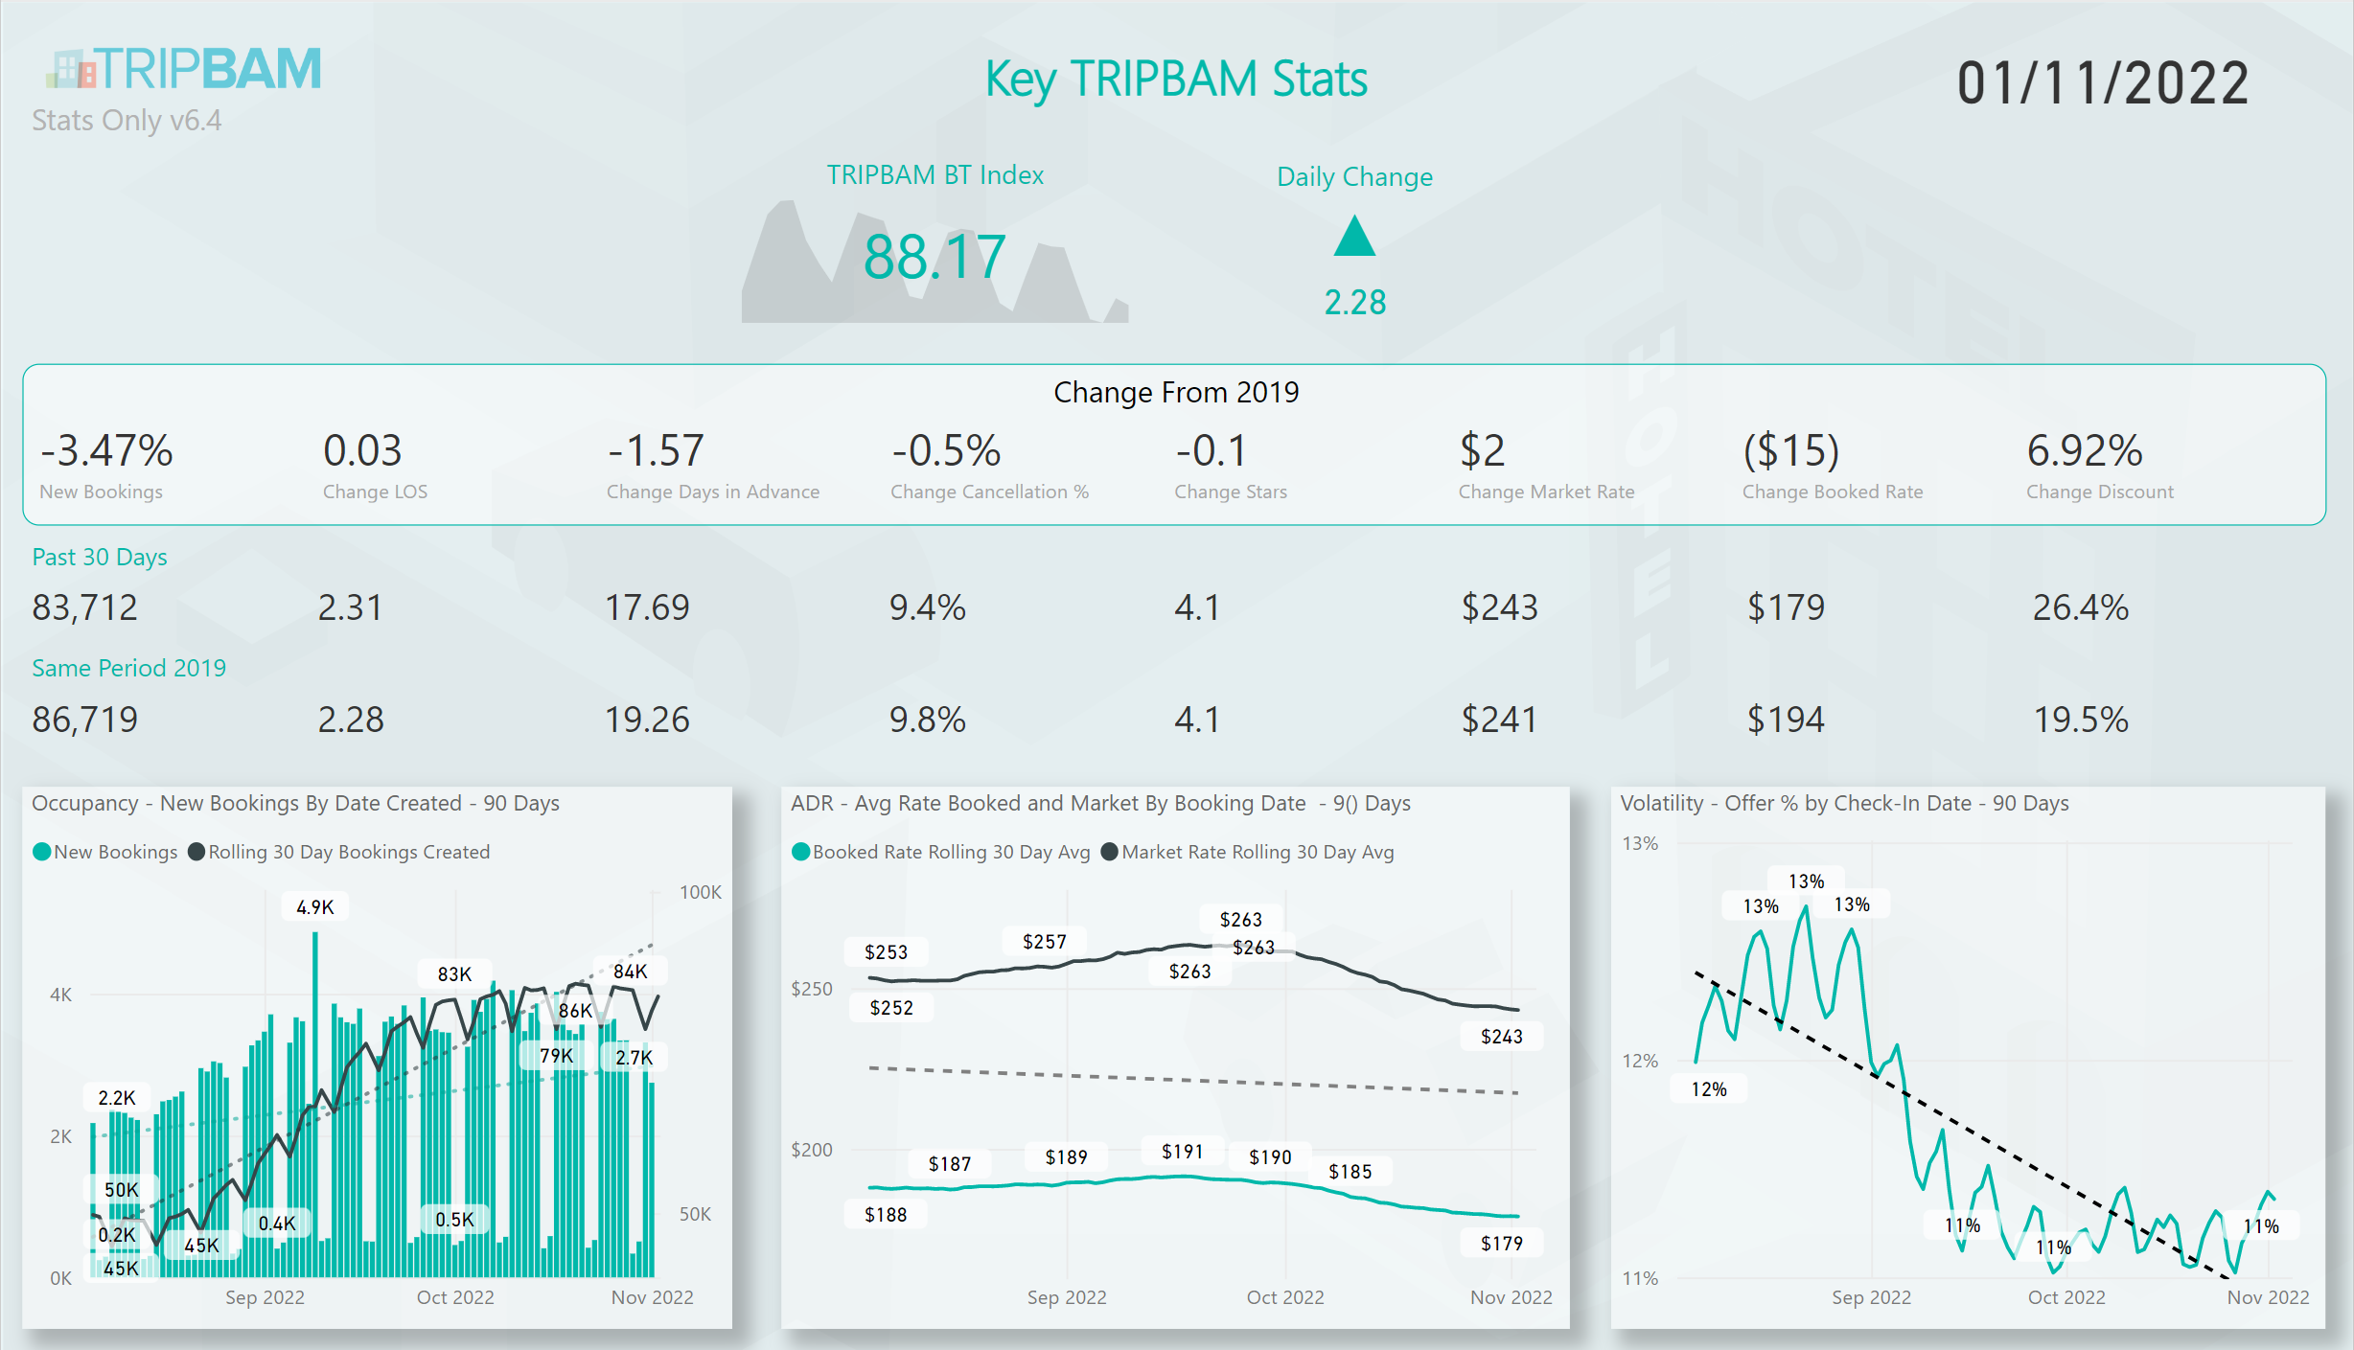
TRIPBAM EMEA Snapshot
Volumes only 5% behind 2019
Sharp recovery after the summer
Longer lead time than global
Higher star rating
Appears to have bigger discounts
Booked rate lower than 2019

Slide 4
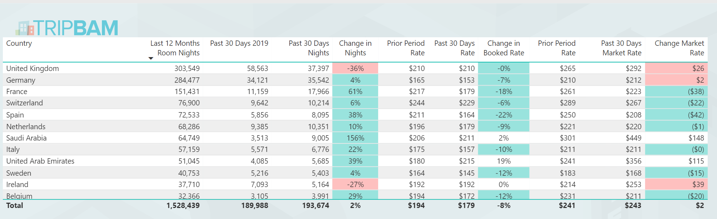
EMEA by Country Performance
UK and Ireland slowest to recover
SA and UAE outperform other countries in both volume growth and rates
France volumes is strong but significant drop in rates (market and booked)

Slide 5
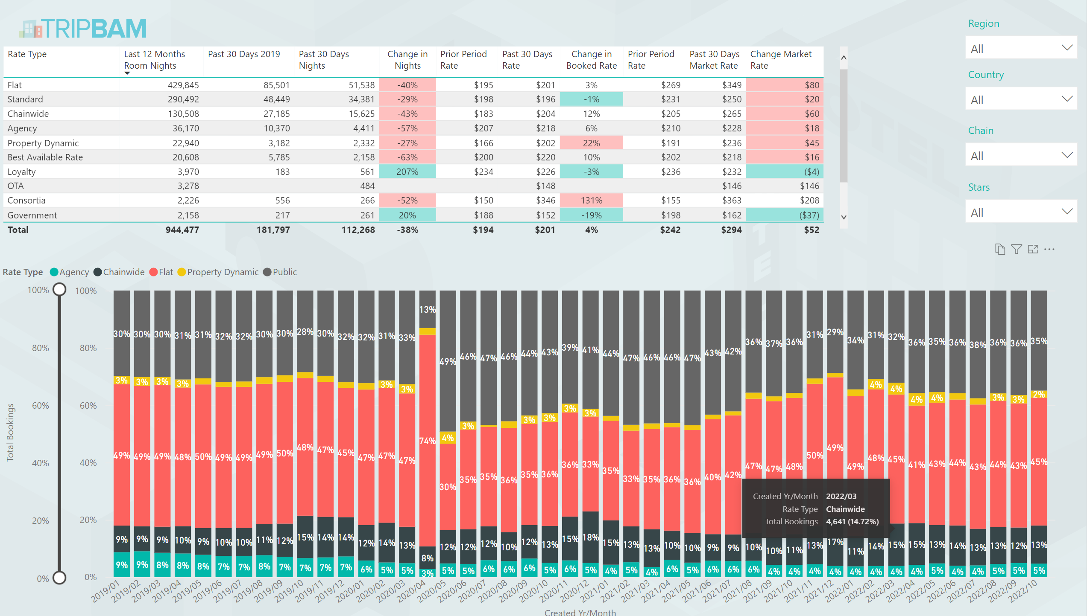
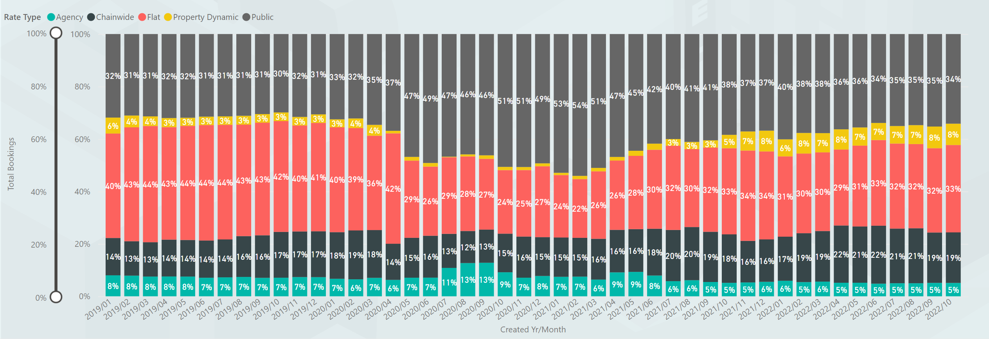
Rate Types Booked
Similar share by rate type to what was seen in 2019
Dynamic and Flat rates have seen increases

Slide 6
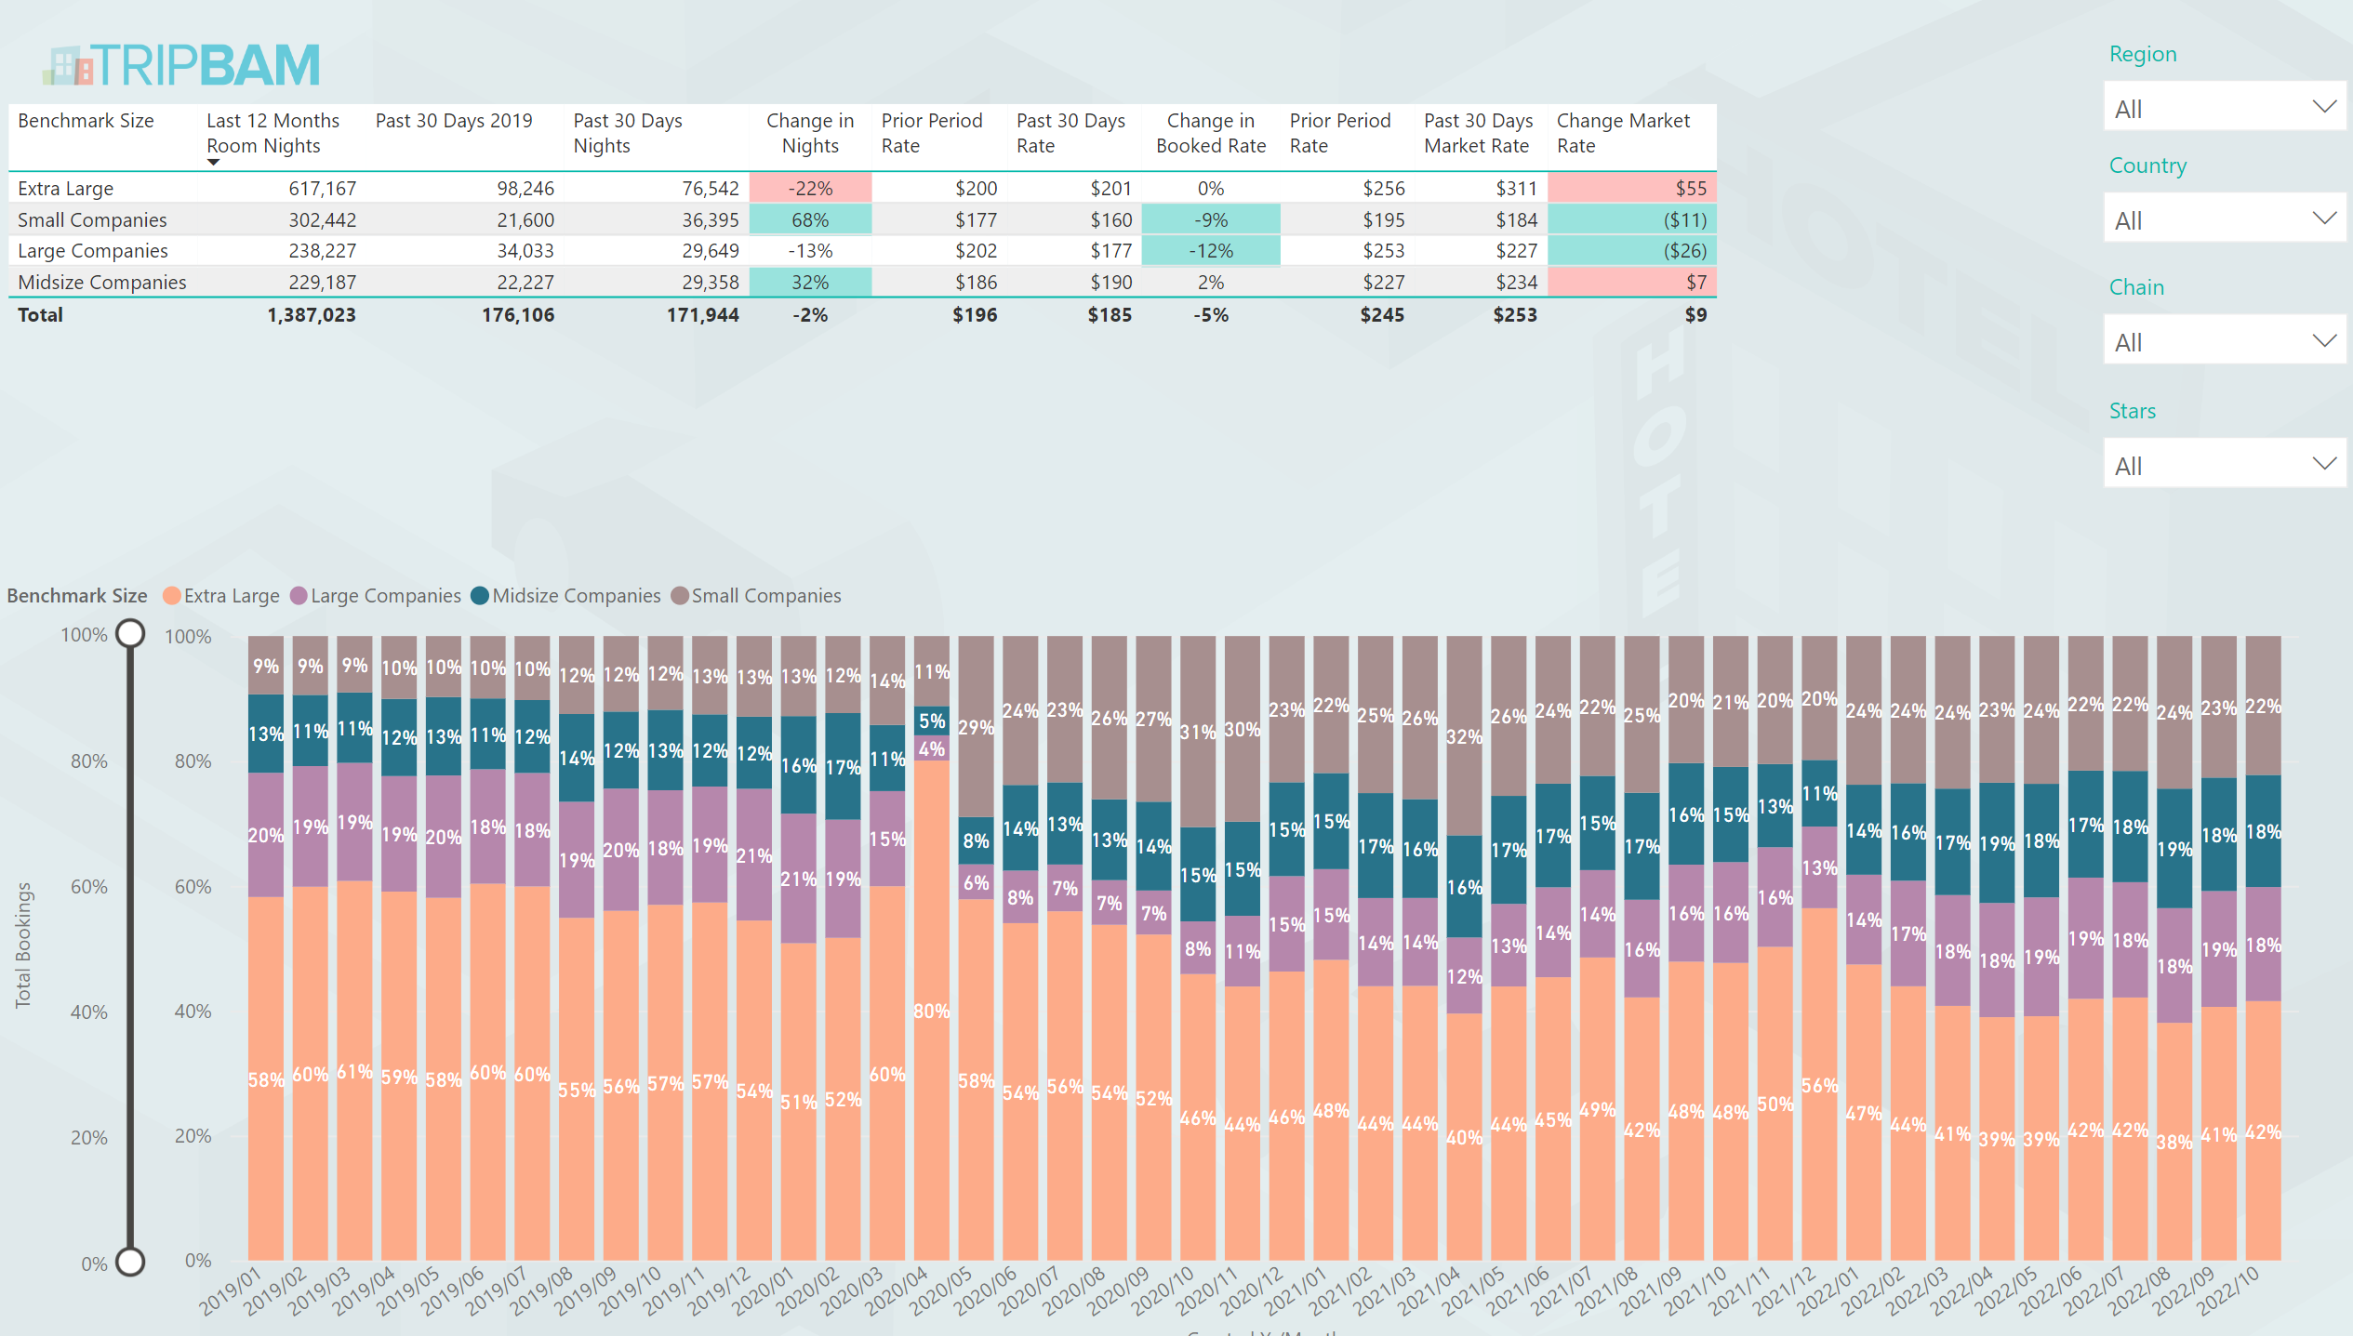
Performance by Company Size
Extra Large slowest to recover in volume
Small companies are capturing better rates and make up over 20% of total volume – previously was less than 10%

Slide 7
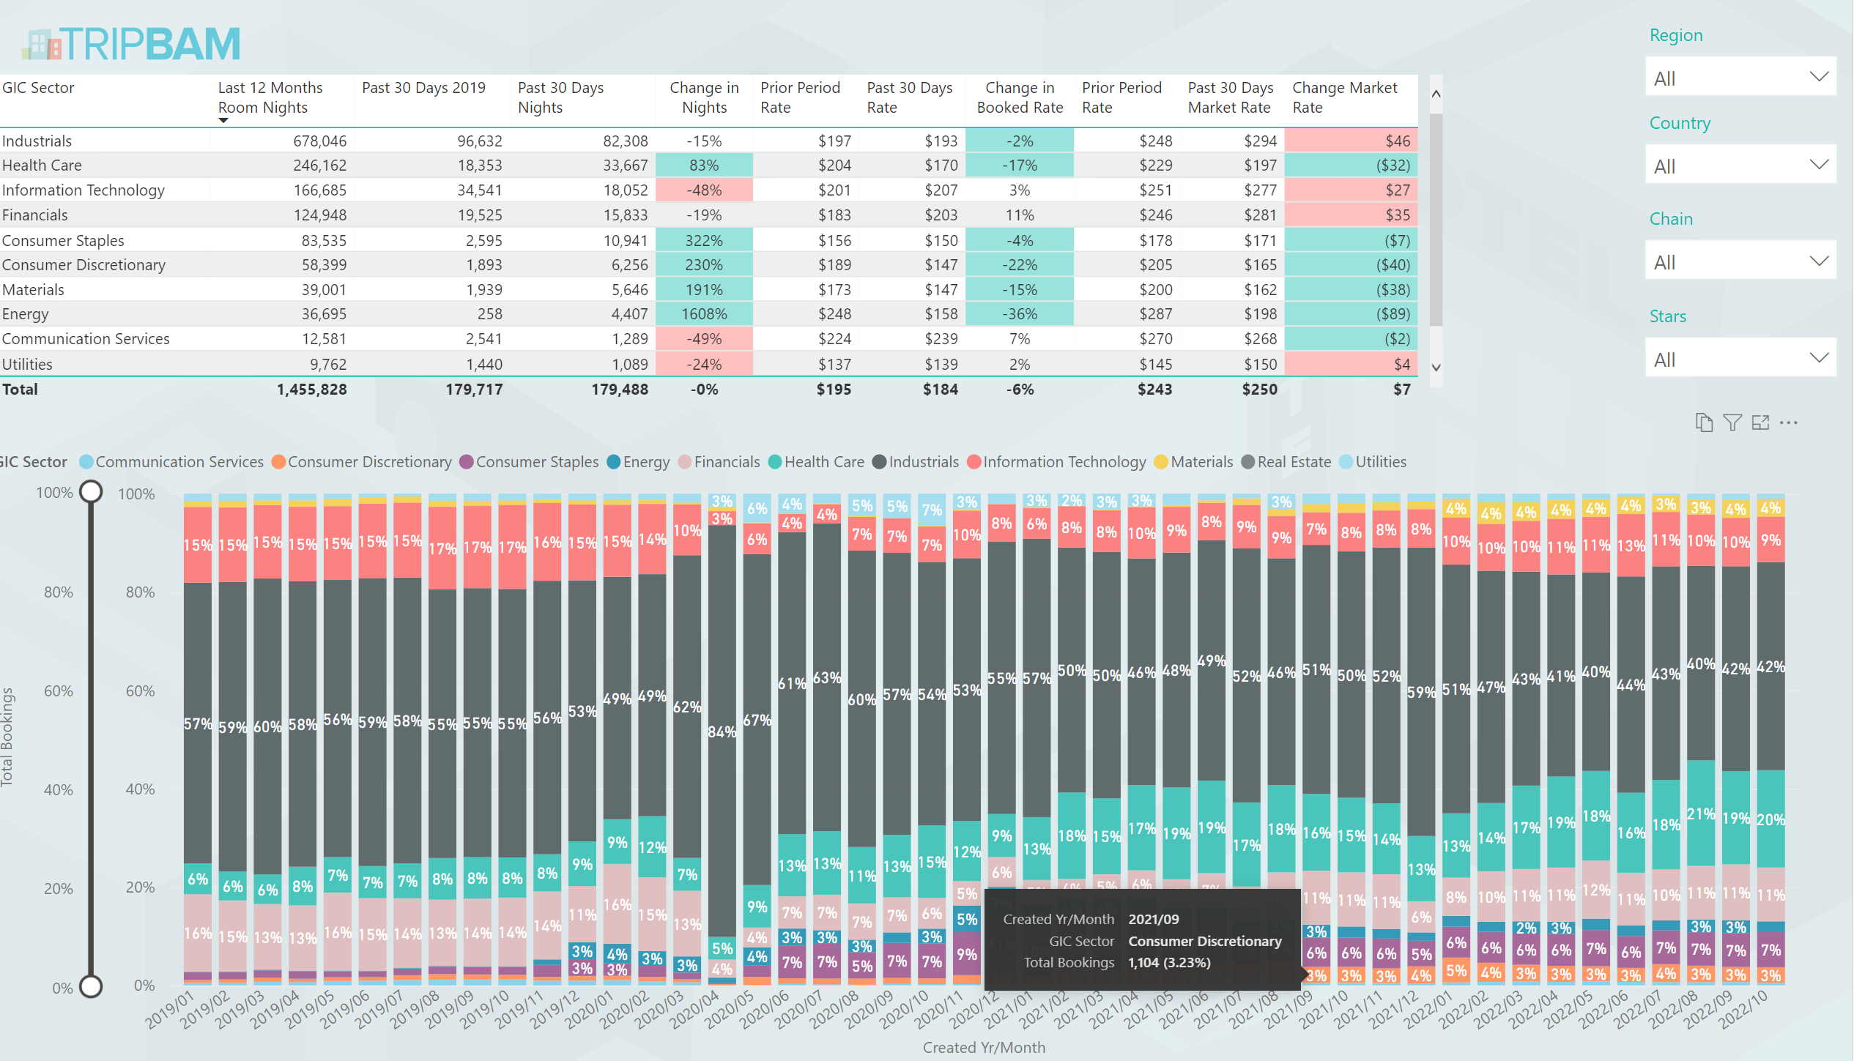
Performance by Sector
IT slowest to recover
Health Care seen surge in volume coupled with a reduction in rates

Slide 8
Before you leave
Give us Your Feedback -
It’s in the App!
1- Click on « Schedule »
2- Find and add your session
3- Move to the bottom
4- Take the survey ☺
Join us to continue this conversation!
« Meet the experts »
Re:Imagine area in the Expo
14:00 – 14:30
Table 11

Slide 9
thank you for attending :)

