Slide 1

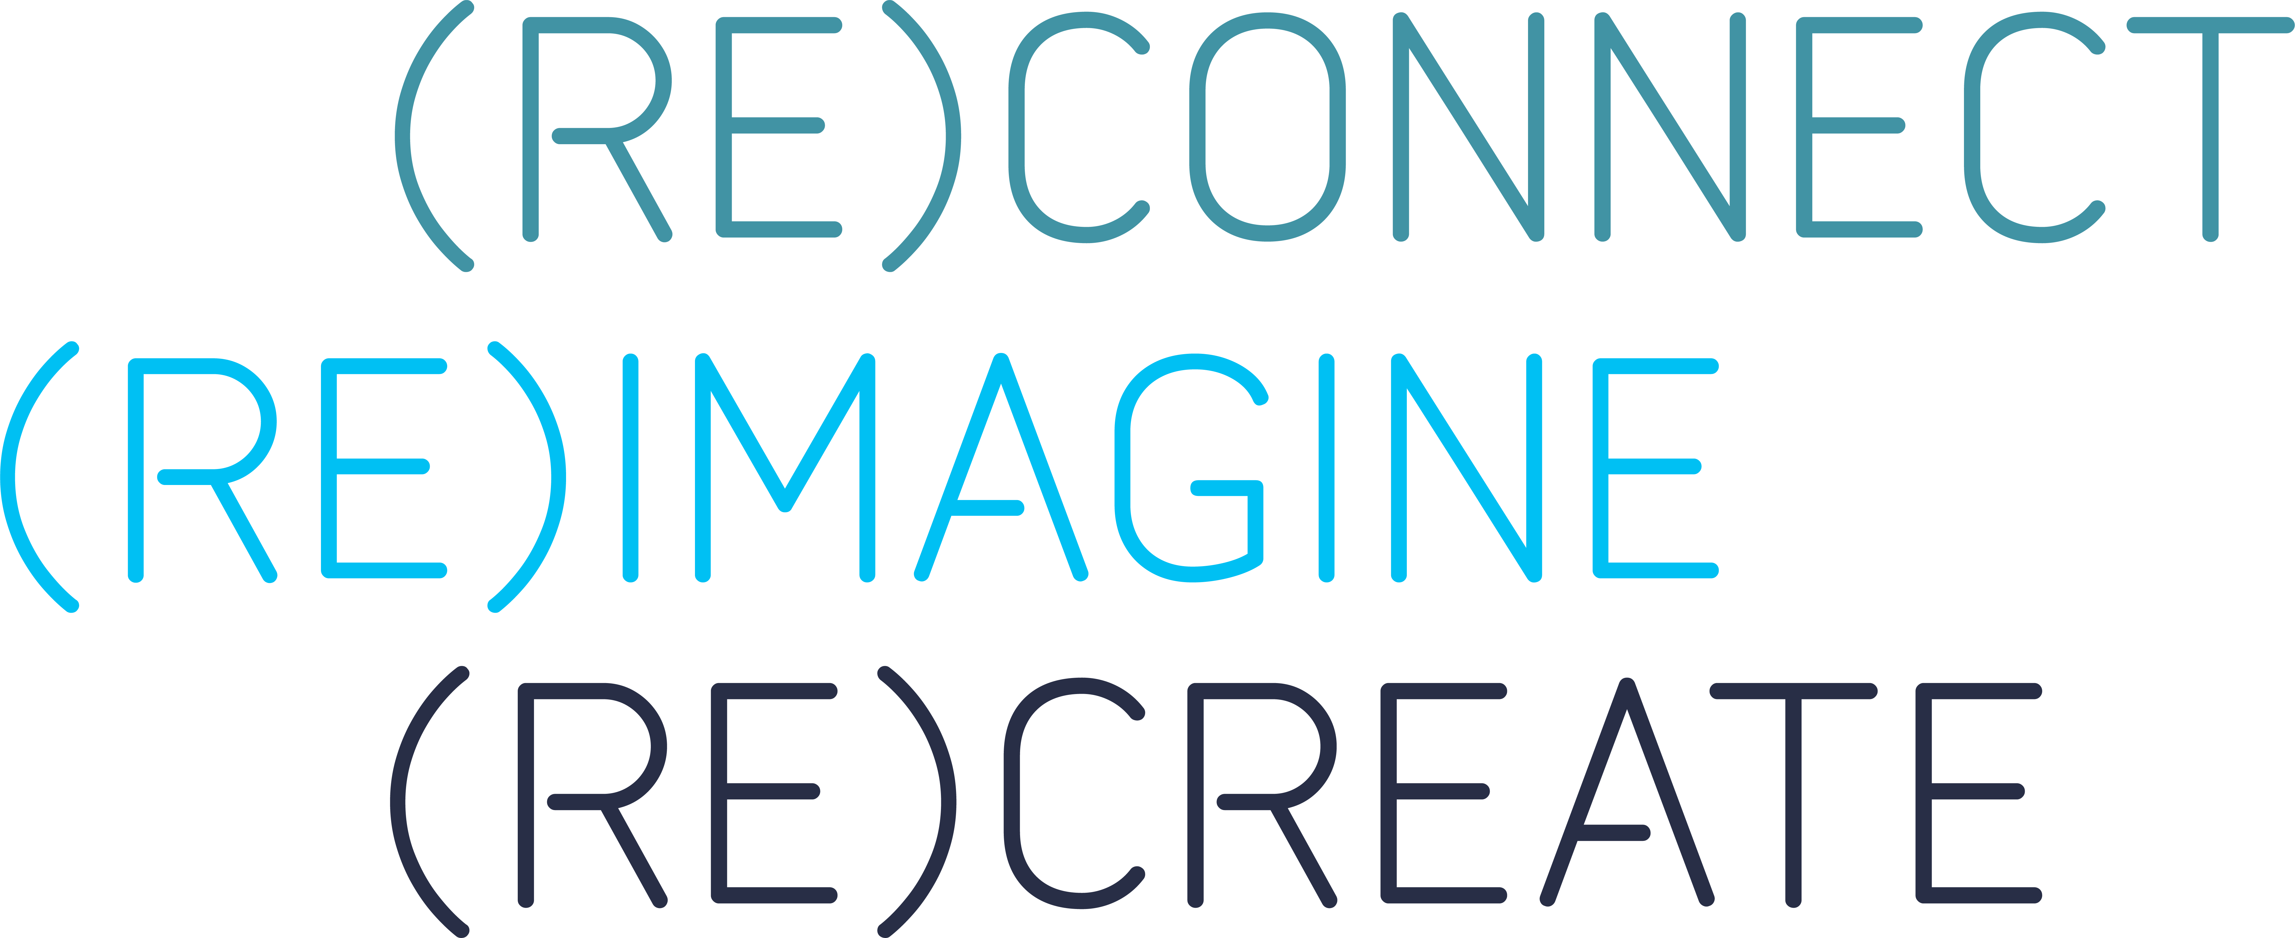
Kelly Ellis, Global Traveler Engagement Practice Lead, Advito
Mauro Ruggiero, Director, Global Travel Management, Finastra
Achieve Your Travel Program Goals With Digital Marketing

Slide 2
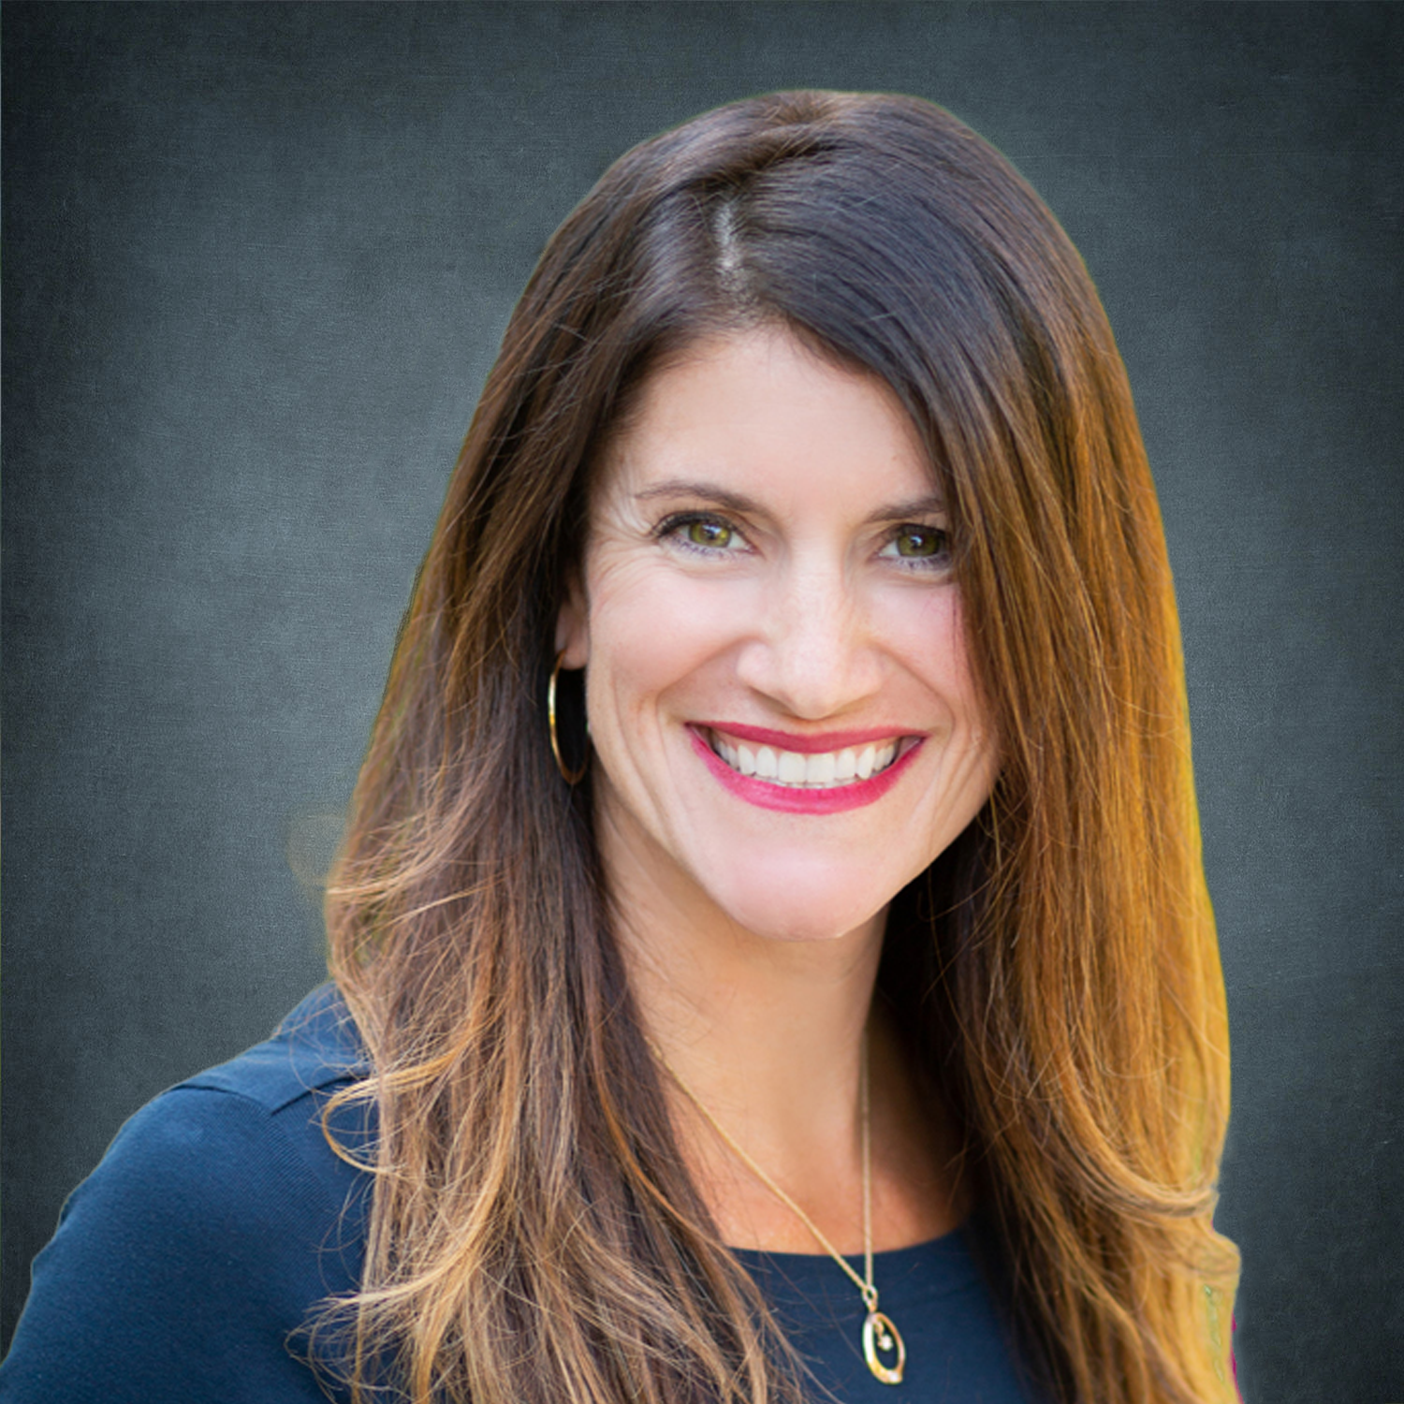
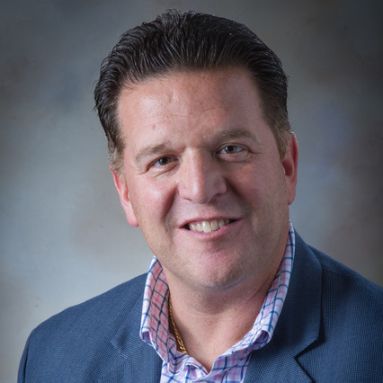
Meet the speakers
Kelly Ellis
Mauro Ruggiero
Global Traveler Engagement Practice Lead, Advito
Director, Global Travel Management, Finastra

Slide 3
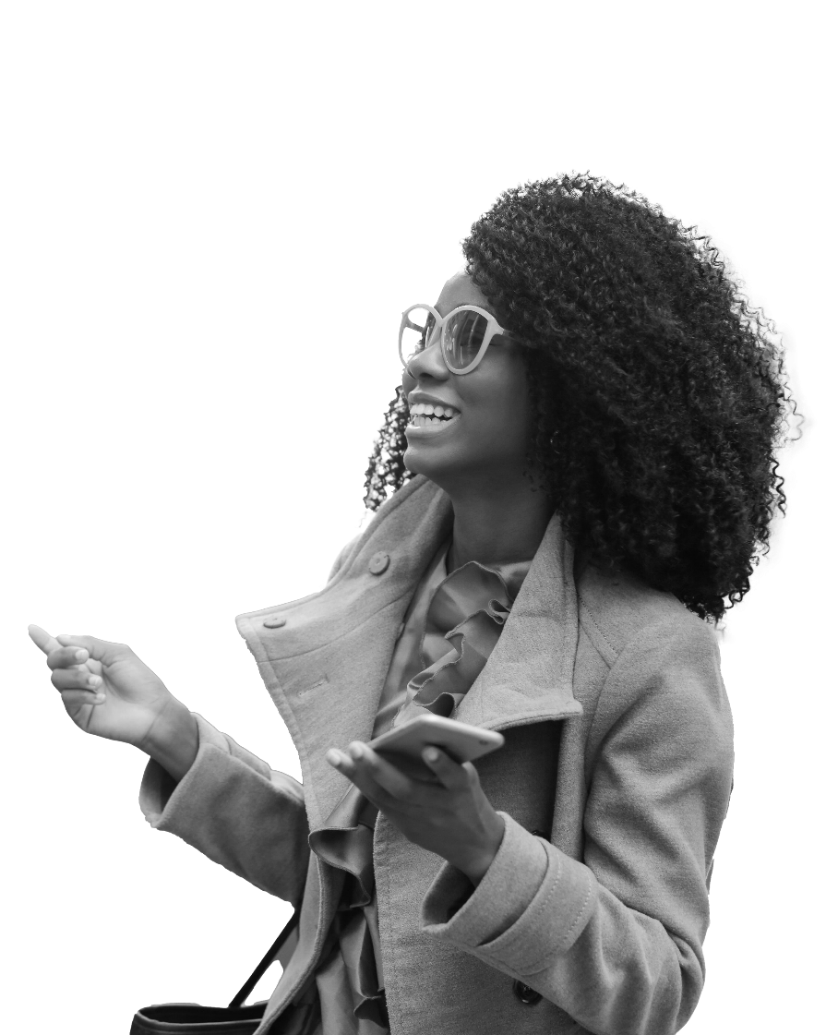
Twenty years ago, choosing travel was simple.
In the digital age, travelers’ choices are limitless.
Notes:
1 minute
Twenty years ago, choosing travel was simple – you called your TMC. In the digital age, choices are limitless.
Today’s business travelers are just like any other digitally savvy consumer, and if you don't use the same marketing tactics that they are used to seeing outside of your program, this is when they’ll start exploring other options.
All of the work that goes into building a program is absolutely pointless if a traveler isn’t using it.

Slide 4



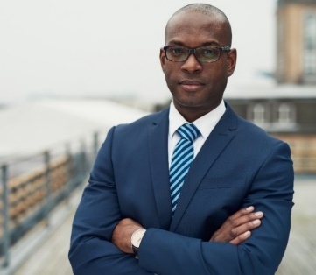
What drives their decisions?
`
`
Program
awareness
Program
utilization
Booking experience
`
`
Digital experience
Health & safety
Sustainability
Notes:
1 minute
Industry headlines, surveys
Not satisfied, modern, communicate
Traveler go rogue
Don’t know it exists
Don’t use tools – clunky, too much time
Not comfortable with new tools
Influence by media
It’s in industry news headlines and surveys all the time. Travelers aren’t satisfied. Programs aren’t modern enough. Travel managers don’t communicate enough.
Travelers get fed up and go rogue, booking on their own. You need to understand what is driving their decisions?
Some travelers just don’t know that a program exists or understand its value. (Program awareness)
Travelers may not be using the program-approved tools because they feel that they are clunky or take too much time. (utilization)
We may be launching new tools to elevate the program that they aren’t’ familiar with, so their comfort level is low. (experience)
Traveler may be influenced by what their hearing in the media around health and wellness even the environment and sustainability topics.

Slide 5

What are your priorities?
`
`
`
`
Supplier loyalty
Policy compliance
Carbon
emissions
Traveler
wellness
Notes:
1 minute
Every travel program has its own unique goals and priorities. Do you know where the gaps are between your goals and your travelers’ behavior?
Engage Mauro – how have your programs changed?
***Virtual card – condition of acceptance**
Flexible & hybrid working?
Virtual meetings & tools
Resources & services
Health and well-being
Sustainability impacting the bottom line

Slide 6
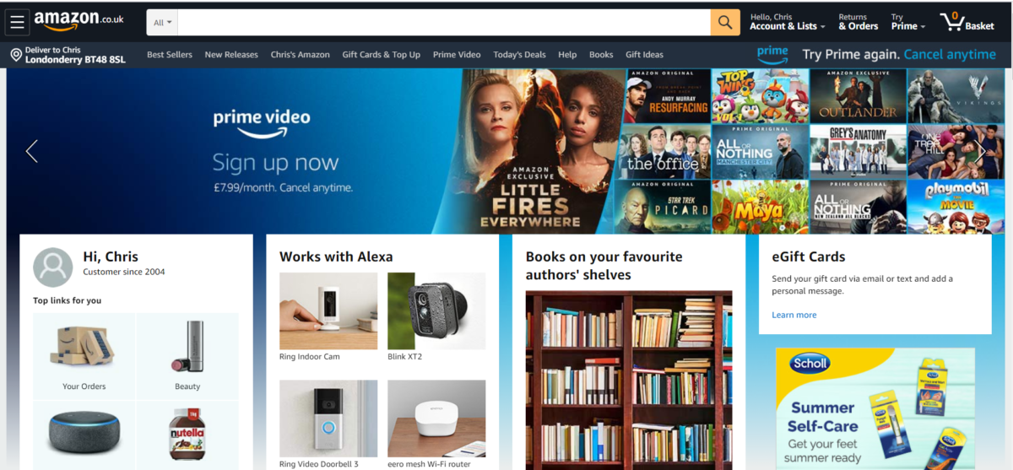
Their expectations are high
Amazon predicts the buyer’s needs at the start of every visit.
Notes:
30 seconds
Today’s leading digital marketers are using data-driven messaging, in the right place at the right time to drive results.
And this affects consumer experience and satisfaction.
When things feel seamless, it’s easier for the consumer to make the purchase decision that the brand is looking for.

Slide 7
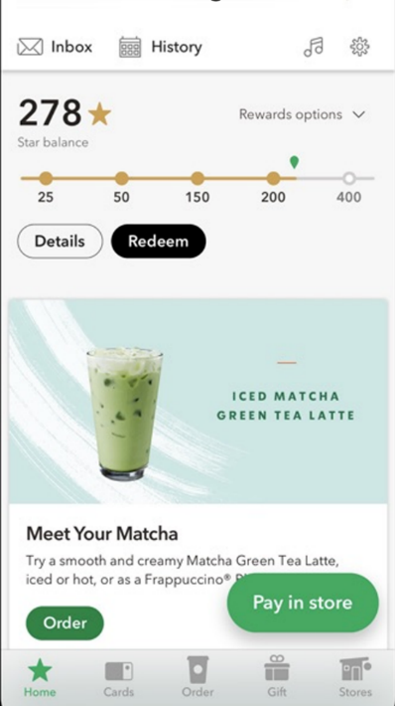






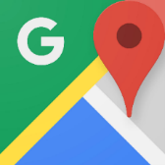






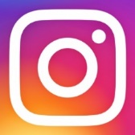
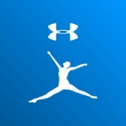
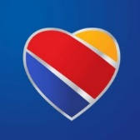


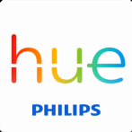

Travelers are digital consumers
Notes:
1 minute
High expectations
Look at the digital experiences they are used to
Constantly bombarded
Starbucks example
Leading mobile pay app
Beat Apple and google
Info gathering, selections, pre-orders, special offers, incent, payment
Travelers have high expectations.
Look at the digital experiences they are used to as consumers.
They are constantly being bombarded with marketing, advertising and communications in nearly every online (and offline) channel, all the time!
Take Starbucks as an example of a digital consumer experience that works.
It’s actually the leading mobile pay app. Starbucks beat Apple and Google by digitizing the consumer experience completely in their mobile app.
From information gathering, to selections, pre-orders, special offers and incentives, all the way to payment.
Starbucks is the true marketing funnel.

Slide 8





Modern consumer journey
Awareness
Findability
Consideration
Conversion
Advocacy
The consumer becomes aware they have a need
They search for a product or solution
They research and evaluate their options
They make
a purchase decision
They become happy brand ambassadors
Notes:
2 minutes
This is how the consumer journey looks for most people today. This typical customer map is what marketers use to identify potential touchpoints to craft their messaging.
Let’s take it back to the Starbucks example…
One day I wake up in the morning while I’m traveling for work in San Diego, and I am craving a really good caramel macchiato. (AWARENESS)
I head to the internet and search for best caramel macchiato in my nearby area. I see there are few boutique coffee shops, and of course the big players like Dunkin and Starbucks. (FINDABILITY)
I compare a few reviews and check the prices to scope out my options, but I’m in a hurry to get over to the GBTA show so I need to be able to order ahead to make sure it’s ready. So, I open up the Starbucks app and see that there’s a store in my location. (CONSIDERATION)
I also see that I have enough loyalty points for a free muffin, so I place my order and head out the door. (CONVERSION)
My coffee really hits the spot, so I post on Instagram from my train seat showing my coffee with the scenery in the background (ADVOCACY)

Slide 9
Bridge the gap with marketing
Build a travel brand identity and drive awareness
Communicate across multiple channels
Influence in your booking tools with merchandising
Traveler books and takes the trip
Create program advocates with satisfied travelers
Awareness
Findability
Consideration
Conversion
Advocacy
Notes:
2 minutes
So, taking that same consumer journey let’s begin creating an experience in your travel program. This experience should bridge the gap between your program priorities and traveler behavior.
Build a brand and an identity that is trusted.
Take a multi-channel approach. Let’s communicate with our travelers in their preferred platforms – could be social, could be mobile.
We need to think about how our traveler as being influenced and use behavior economics tactics to nudge those decisions.
By understand our audience in today’s environment we can deliver the right message at the right time.
Your satisfied travelers can become brand advocates and help sell your program for you.
Let’s see how our two leading Travel Managers have adopted this approach.

Slide 10

Building a Travel Program Brand
Notes:
30 seconds
Laying the groundwork
Marketing is about building trust and we do just that with 100% of our client projects. We align with our client’s corporate brand to strengthen their travel brand.
Alongside a wordmark or logo, we recommend developing corporate icons, collateral templates and taglines to support and build the foundation for brand recognition.
We’d like to take a few minutes sharing some real-life example…

Slide 11
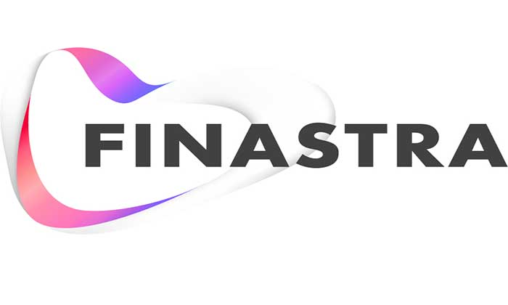

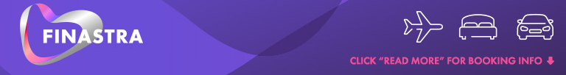

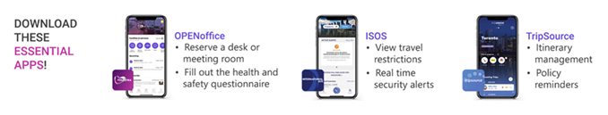
Building a brand
Notes:
2 minutes
Mauro – We’ve gone through a number of iterations with the Finastra brand over the years. Talk to us about how you use the main company logo and support it with taglines to draw attention to travel.

Slide 12
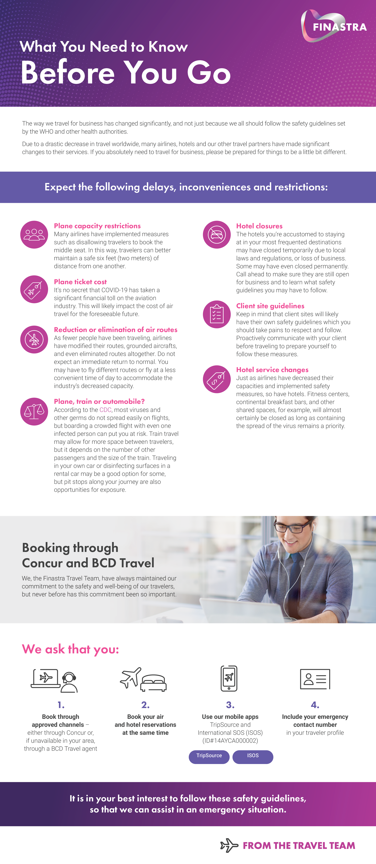
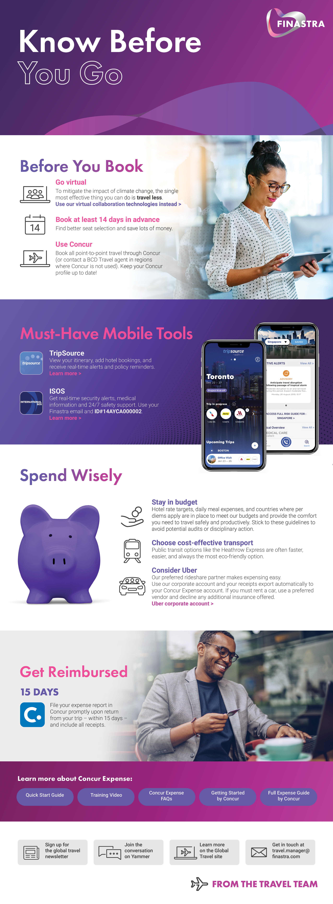
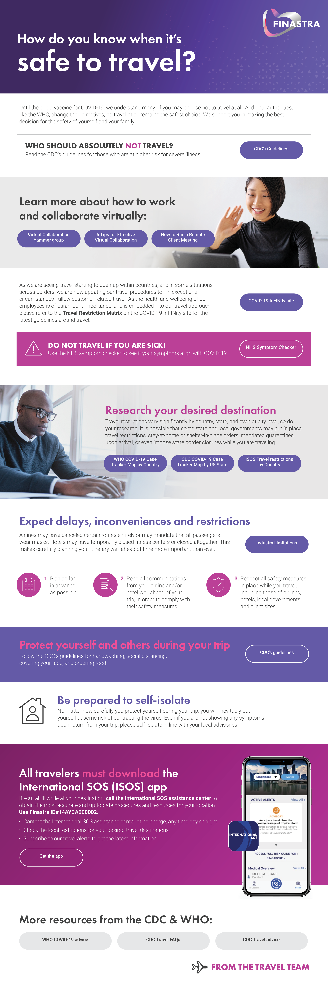
Staying relevant
Notes:
1 minute
With products changing at a rapid pace, staying relevant has been and will continue to be a priority with digital marketing tactics.
Mauro – what steps have you taken over the past 2 ½ years in keeping your communications trustworthy and relevant to the changing travel environments?
Preparing for travel – the comeback
Reminders of approved channels
Know before you go supporting documents communicating changes and travel updates
Awareness on how to travel safely and tapping into tools and tech

Slide 13

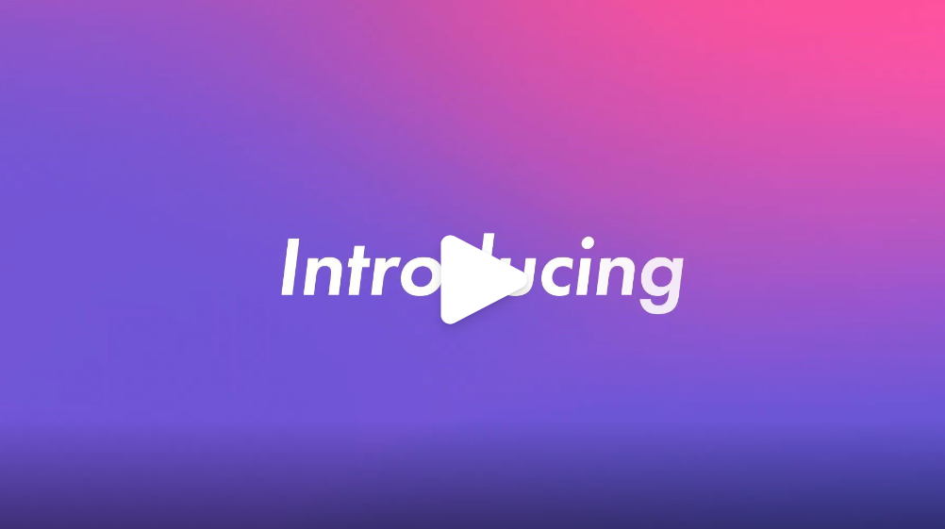

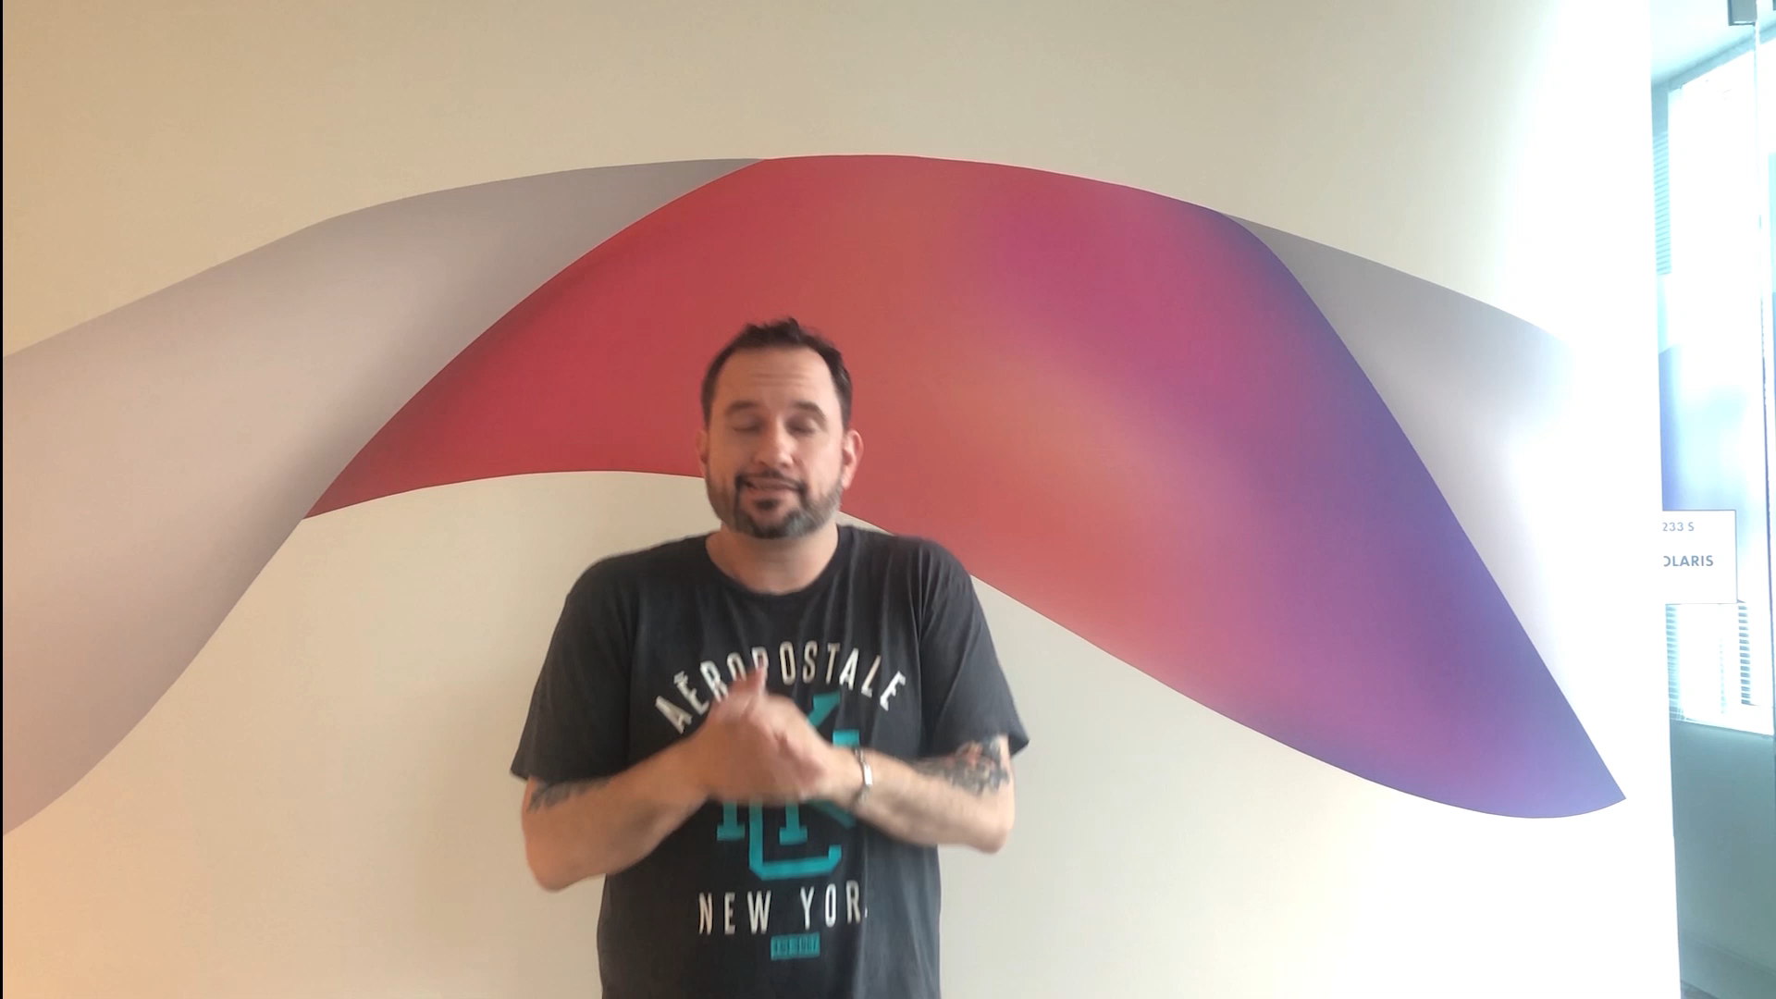
Catch attention with short animated and TikTok-style videos

Slide 14
Take a Multi-Channel Marketing Approach
Notes:
30 seconds
By taking a multi-channel approach it allows us to communicating with travelers in their preferred platforms so they can find the information when they need it.
I may be an occasional traveler who will seek the info on our intranet pages when I have specific questions. You may be a frequent traveler who is tapped into our internal social channels gathering updates as they come in from the travel team.

Slide 15
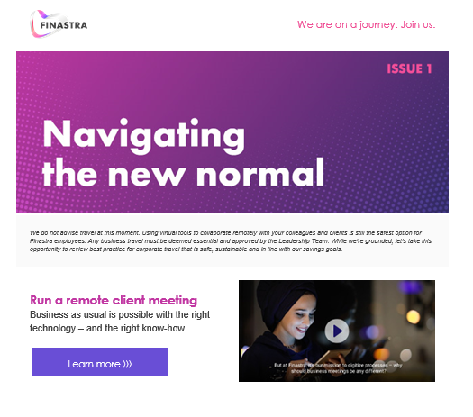
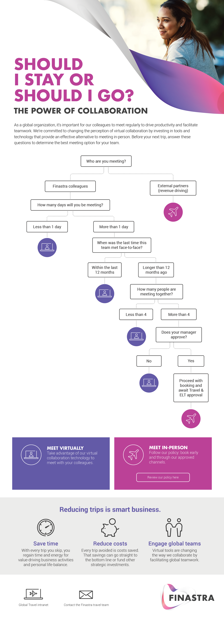
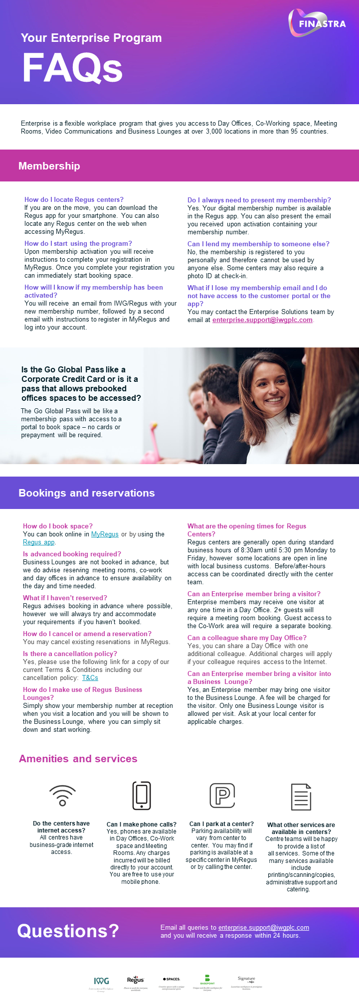
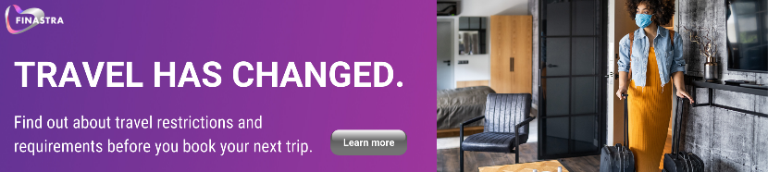
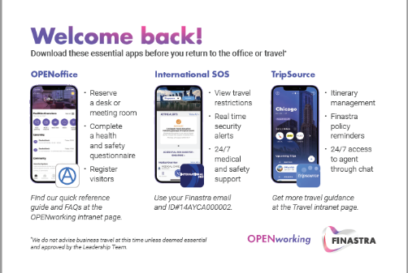
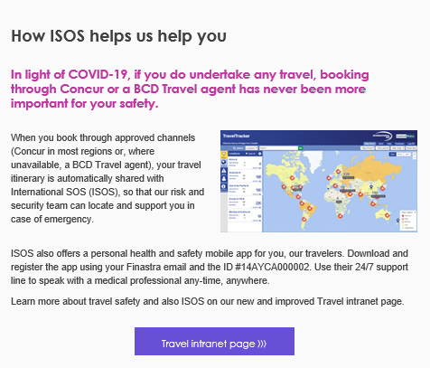
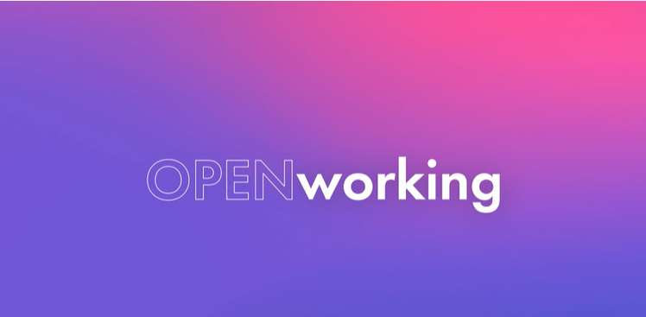
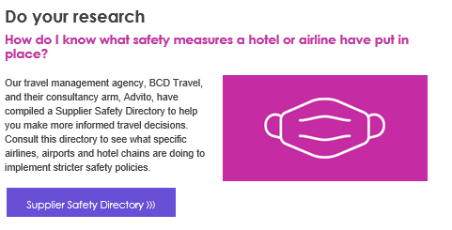
Leveraging all channels
Notes:
2 minutes
Let’s talk a bit about leveraging all channels to drive confidence and satisfaction.
Mauro - how have you utilized the channels at your disposal to instill confidence over the past 2+ years with your travelers and arrangers?
We cannot have enough channels to get your message out. Leveraged all existing channels and keep your ears open for new channels on the horizon.
Use channels that the travelers are using throughout their journey – before, during and post booking and travel
Launched new apps to help keep traveler safe and up-to-date
Less than 20% of Finastra employees use Yammer – the company as a whole is struggling with social adoptions. However, everything we put in newsletters goes into Yammer to encourage the engagement and touch point
2 minutes
Holly – Halliburton has embraced a number of company-approved channels and platforms for distributing messages. Yammer, SharePoint, itineraries, mobile apps and more. Talk to us a bit about how you approach different audiences with different channels.
Bring MS Teams into the convo for demographic/generational discussion
Messaging in itineraries and mobile apps - messages at the right time when it’s most relevant
Tips, tricks and hacks
Follow-up question if we have time – What are some pros and cons of managing multiple channels and communities?
Finding the balance of the right number of touchpoints. You don’t want to over communicate so needing to be strategic is a key.
Sample message shared through:
Announcement emails
Online booking tool banners (x2)
Yammer posts (x3)

Slide 16
Influence With Merchandising
Notes:
30 seconds
Merchandising is a retail marketing term for the activity of promoting the sale of goods. We’ve converted the term into our travel environment with the meaning of everything you do to promote and sell your product, service, or best travel decision once the traveler is in your store or online booking tool.
Just like traditional or online retailers push tailored content to shoppers to drive them toward specific buying choices, we use proven merchandising techniques to target your travelers’ searches within your online booking tools (OBT). Encouraging the right travel decisions through digital marketing.

Slide 17
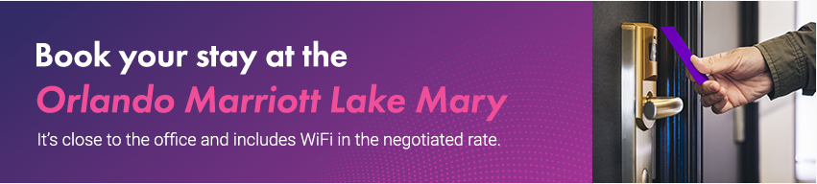
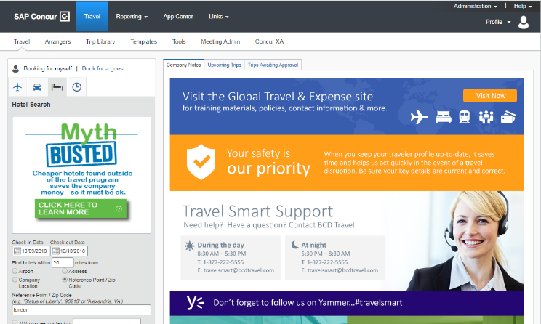
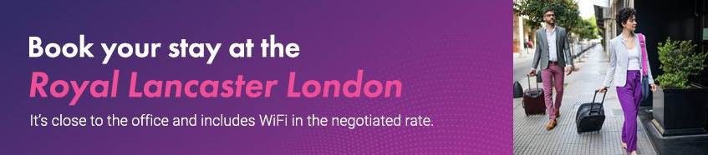

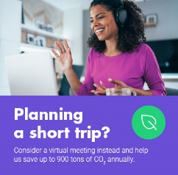
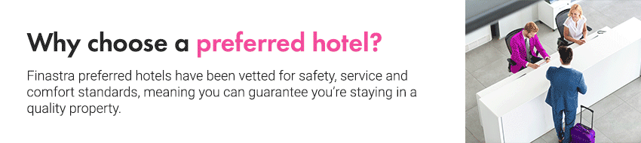
Guiding decisions with messages
Notes:
2 minutes
Mauro – We’ve created hundreds of banners for Finastra over the past 6 years. What types of messages do you find to drive the most impactful changes?
Behavioral economics – the freebies, the benefits, give them a target
Changing behaviors can be trickly, but if you highlight the key benefits to the travelers - the WIIFM, then they really start thinking about it.

Slide 18
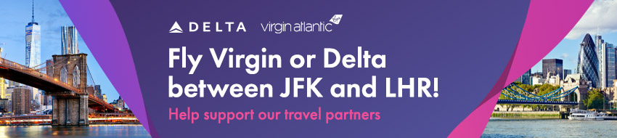
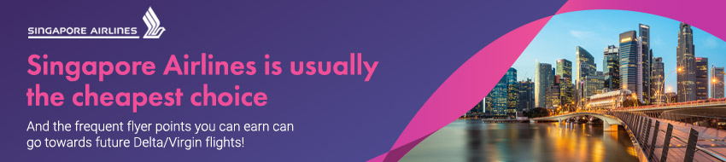
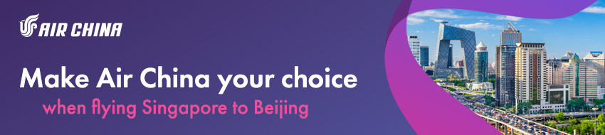
Shifting shares with route-specific messages
Notes:
2 minutes
Market-specific information – right message at the right time.
Encouraging policy compliance – such as reminding travelers to update and complete their travel profile
Tap into social channels for quick hit messages
Link to supporting documents or tools to access
Allows the community to share feedback or comments - social proofing
Social proof is a psychological and social phenomenon wherein people copy the actions of others in an attempt to undertake behavior in a given situation.

Slide 19
Build Travel Program Advocates
Notes:
30 seconds
Let’s spend just a few more minutes exploring how your satisfied travelers can become brand advocates and help sell and promote your program for you.

Slide 20
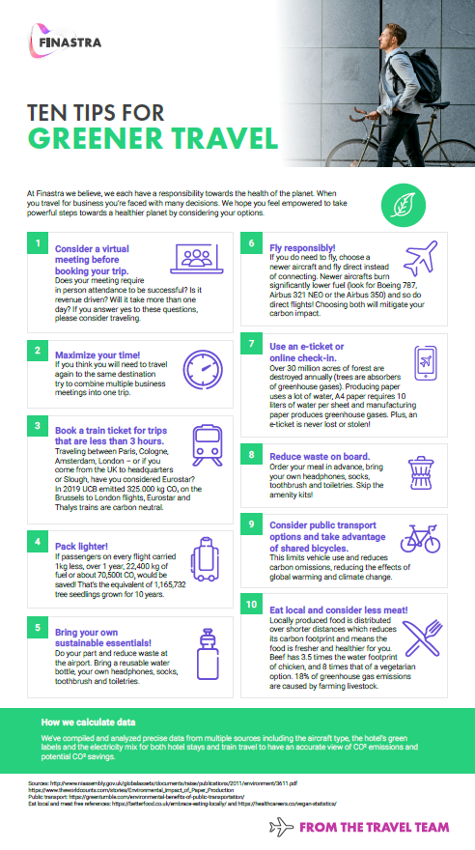

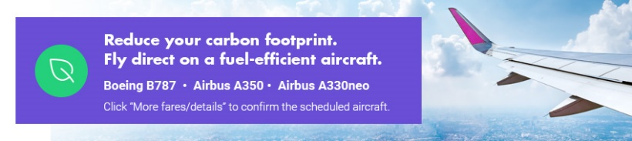
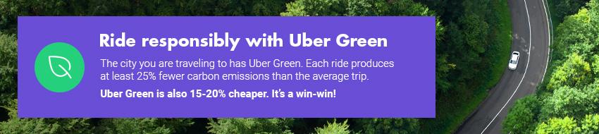
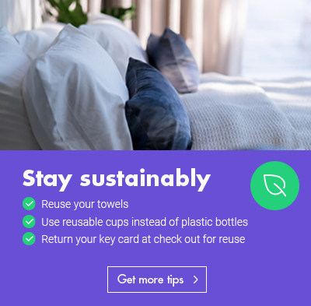
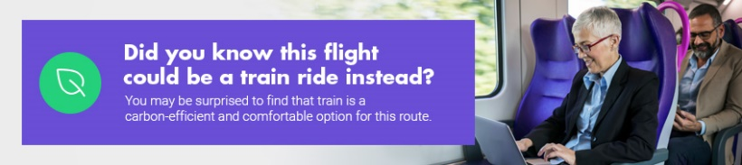
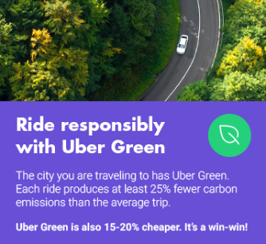
Be a part of the change
Notes:
2 minutes
Mauro - Talk to us a bit about how you're engaging and building your brand advocates with your sustainability focused campaign?
Education, communicate and innovate – we’re in the first two phases, and haven’t proactively touched the innovate yet.
Travelers really want to see sustainable topics today
1-CEO is big into the topic
2-a large population in the org has show interest in the topic
We’re taking strategic steps with communications and aligning with the company task force
We want to make travel the leader by encouraging social proofing -
By driving the strategy, we allow our traveler to feel like they are a part of the change
Educating and structuring the program makes them happy satisfied travelers.

Slide 21
Build your strategy
  Define goals
  and priorities
  Map campaigns and develop messages
  Launch and promote programing
  Conduct channel and asset inventory
  Develop marketing calendar
  Measure and refine
  DISCOVER
  PLAN
  IMPLEMENT
Notes:
2 minutes
We wanted to round out our slides by showcasing the roadmap that we follow to strategize and successful implement digital marketing into our travel programs – Discover, Plan, Implement and refine/pivot, as necessary.
10 minutes for Q&A
As we close out we wanted to share a couple takeaways from each of our travel managers…
Kelly - In a nutshell, a well marketed travel program makes travel more strategic –
more people will book in the approved channels,
it will drive savings,
fulfill duty of care,
hit sustainability targets and
lead to satisfied travelers.
Finastra – there’s a difference with our travelers today. Once you stop communicating people will revert back to their bad habits. The questions will begin to creep back in - - so we take the approach of consistent, continuous communications.
Halliburton – whether your program is mature or just getting off the ground, building that trusted foundation so your travelers can and will rely on the info to make educated, in-policy decision will naturally build advocate for your program. Ensure you’re aligning yourself with consultants that are honest and will challenge you.

Slide 22
Before you leave
Give us Your Feedback -
It’s in the App!
1- Click on « Schedule »
2- Find and add your session
3- Move to the bottom
4- Take the survey ☺
Join us to continue this conversation!
« Meet the experts »
Re:Imagine area in the Expo
11:15 - 11:45
Table 3

Slide 23
thank you for attending

