Slide 1
Katharina Riederer, CEO & Co-founder, eco.mio GmbH
Decarbonizing business travels with eco.mio

Slide 2
Does this dilemma sound familiar?
The Problem we solve
… and you cannot solve it on your own today?
“GHG emissions must halve by 2030 & drop to net-zero by 2050” – Science Based Targets initiative
“89% of leaders agree that sustainable business travel is vital for their employer brand.”
– BTA
“59% (…) expect higher prices for transportation & accommodations than before the pandemic”
– AirPlus
Carbon offsets
Enforced reduction
Increasingly criticized, actual problem persists
In conflict to the need to travel at short notice and employee satisfaction

Slide 3

We promote a behavioral change by rewarding more eco-friendly behavior…
Our Solution
… synergizing sustainability and cost reduction
MUC-BER, Monday, 8:00 am
Flight Eco:
Train 1.Cl.:
1
Train instead of plane
123 kg CO_{2e}
15 kg CO_{2e}
450 €
240 €
-88%
-47%
2
Economy class
3
Green airline
FRA-NYC
Flight Bus:
Flight Eco:
4
Green hotel
in 90%
eco-friendly = cheaper alternative
2,750 €
1,200 €
2,8t CO_{2e}
1,4t CO_{2e}
-50%
-57%

Slide 4
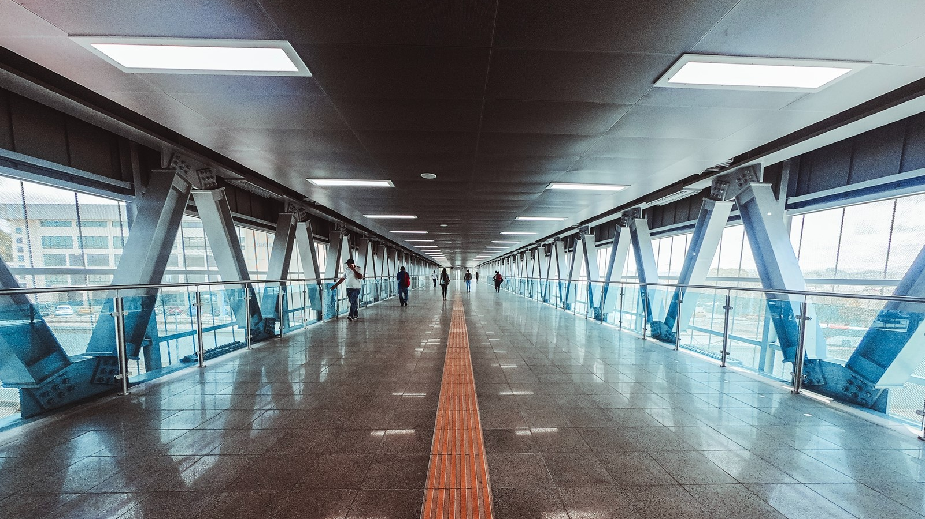



Fully-integrated – Level up your current travel program!
Our Solution
Travel
Policy
OBT
TMC
Reach ambitious climate targets
Save significantly on travel cost
Boost traveler happiness
OBT: Online Booking Tool, TMC: Travel Management Company

Slide 5
Our Solution
Step 1: Determine
CO₂e & cost baseline
Based on historical travel behavior, travel policies & live corporate rates
Step 2: Highlight greener options
Directly in our customers’ online booking tool, right at the point of decision
Step 3: Reward green behavior
Supported by the eco.mio perfor-mance dashboard

Slide 6
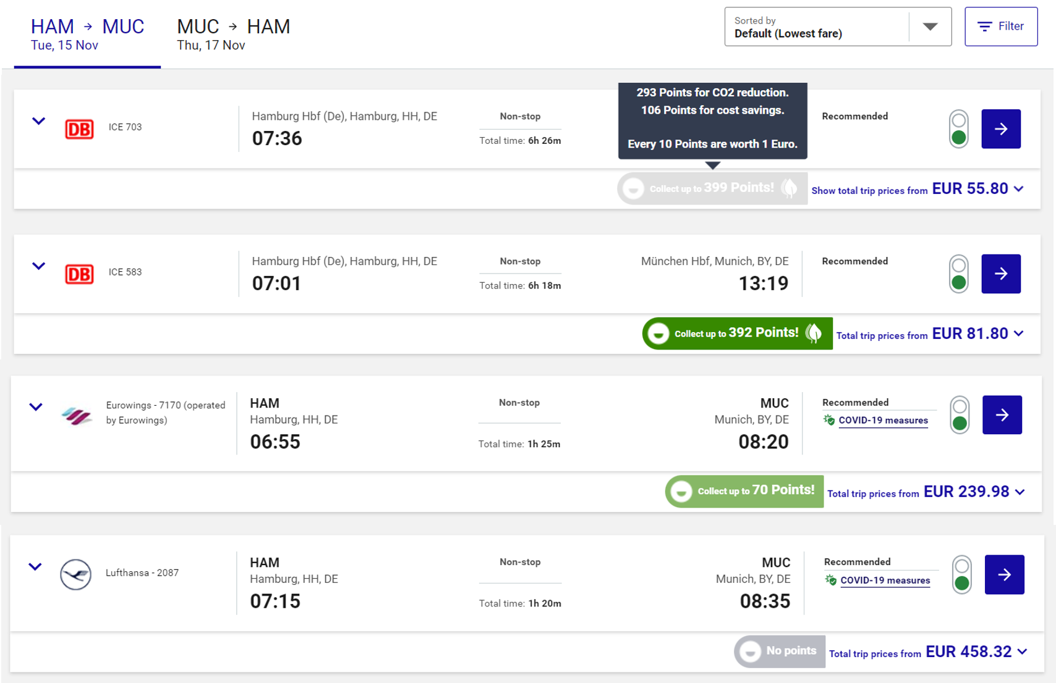
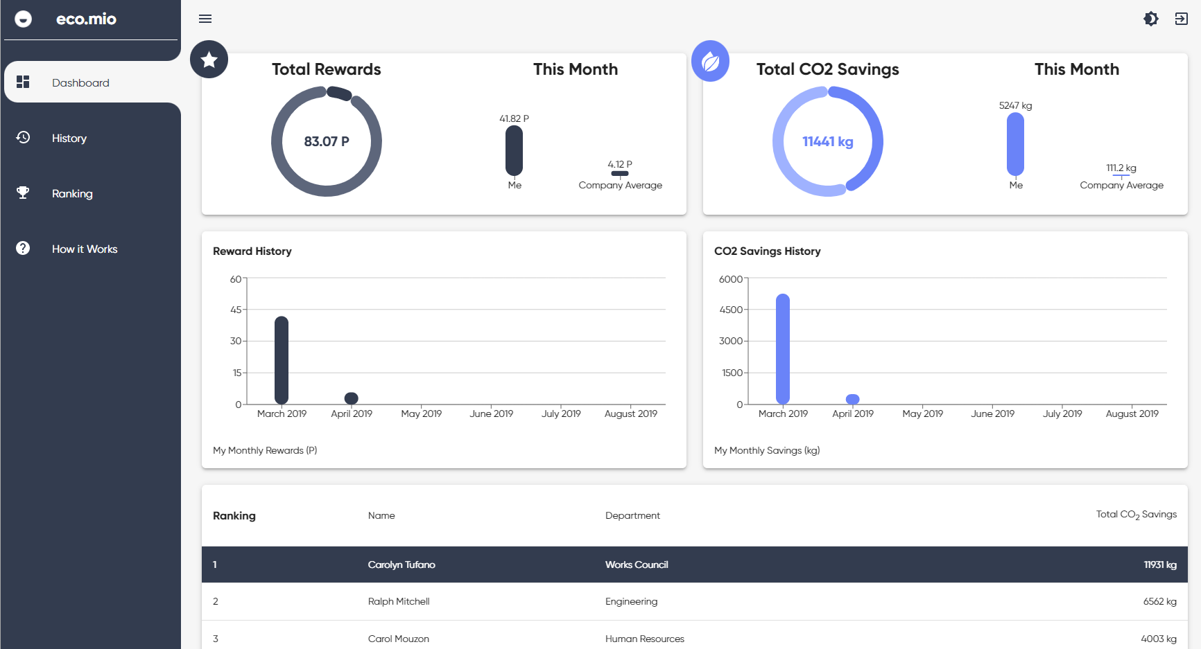
Customized to your needs
Our Product
  Transparency | Climate impact based on atmosfair VDR calculation standard
  Integration | Seamlessly in your online booking tool within days
  Incentivization | Tailored to your travel behavior & climate targets

Slide 7


Selection of an attractive reward system
Our Product
Donation
for a climate protection project
1
Giftcards¹
redeemable via our voucher store
2
Cash-out²
Monthly to the salary account
3
1 Tax & duty free up to exemption limit of 50 Euro p. month p. employee, thereafter taxable according to §37b EStG
2 Fully taxable & dutiable according to §37b EStG

Slide 8
Ready to get started? Let us …
Our Product
… understand your travel behavior and policy
… jointly define the behavior you want to reward
… agree on a piloting scope*
*IT implementation efforts around 2 hours

Slide 9

Paulina Möller & Karina Block Henriksen, Global Travel Leaders, IKEA

Slide 10

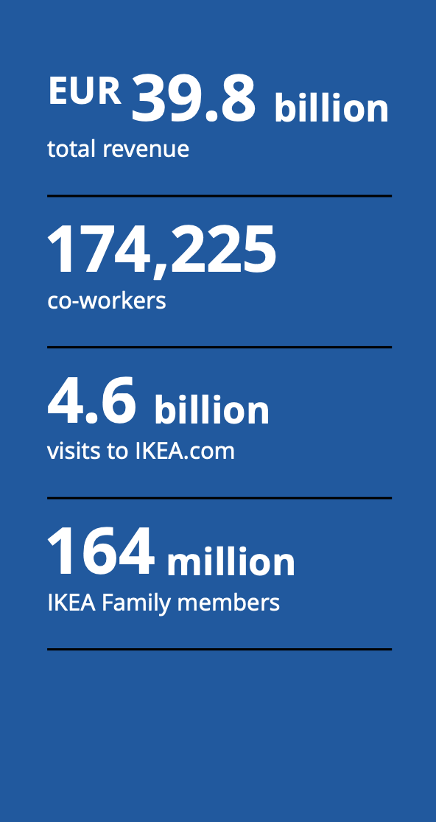
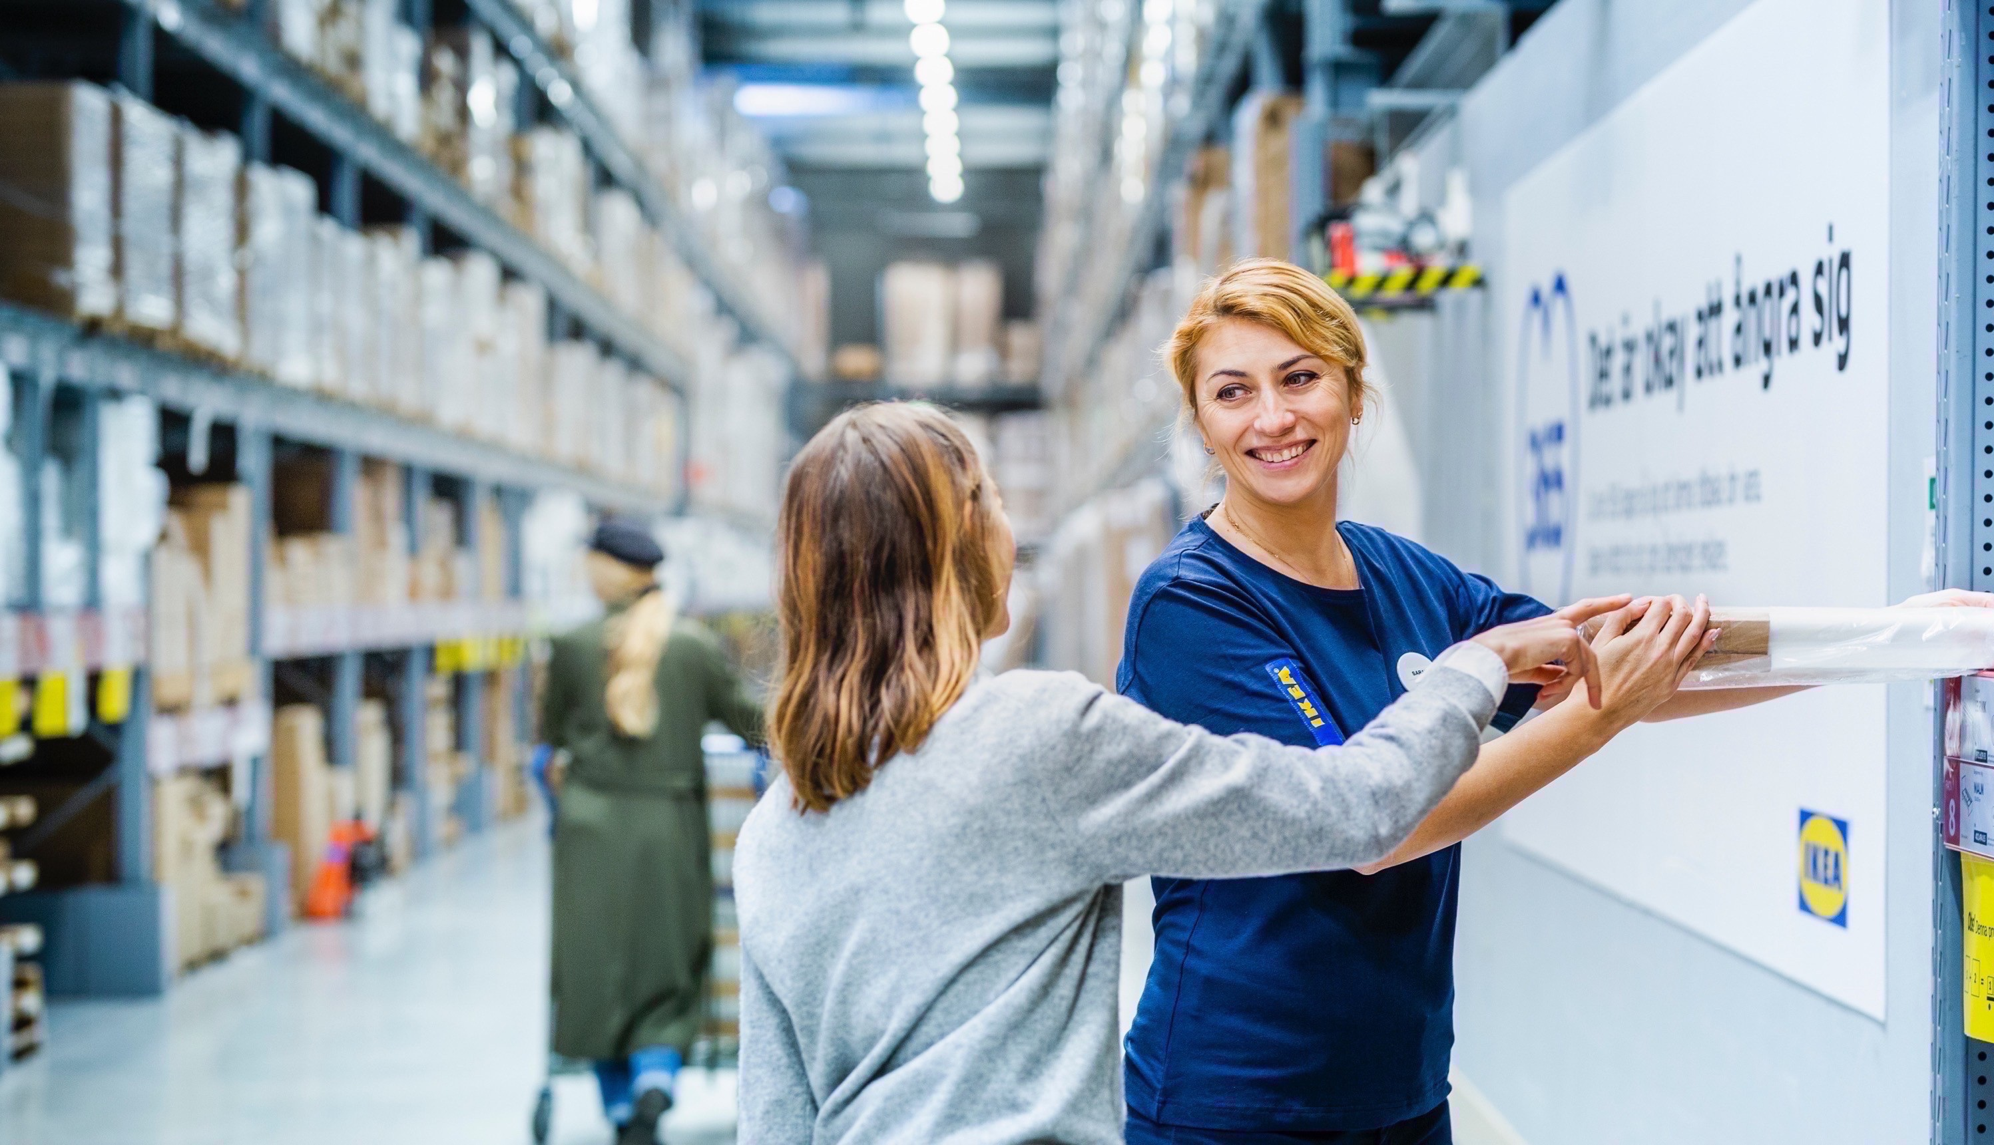
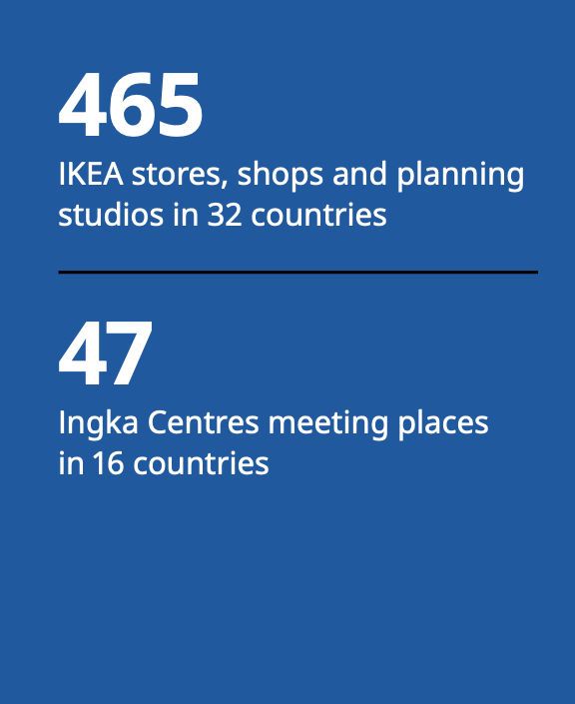
IKEA at a glance FY21

Slide 11
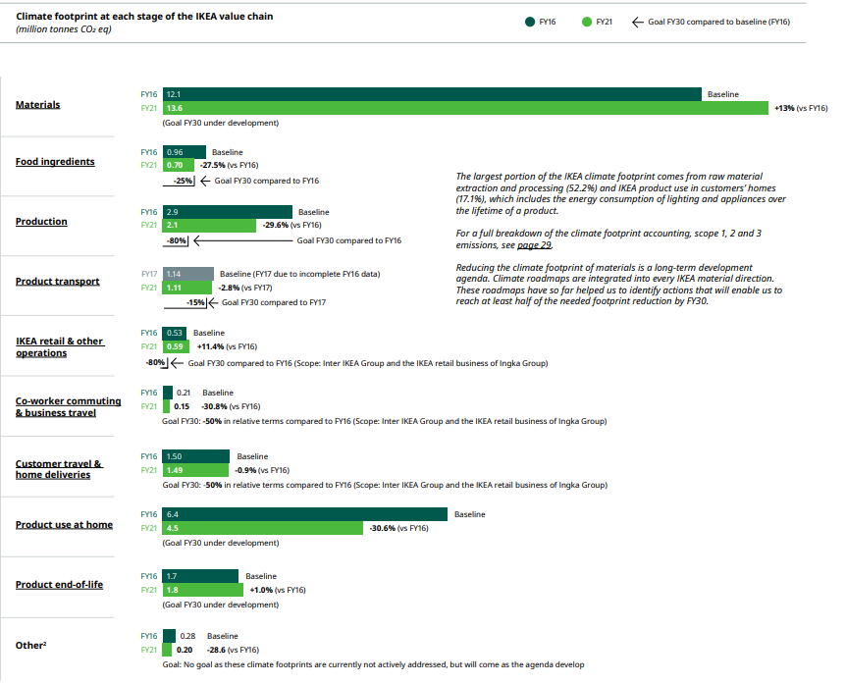
IKEA Sustainability report FY21
Scope 3
Co-worker Commuting and Business Travel
FY16 (baseline) = 0,21 million tonnes CO2
FY21 = 0,15 million tonnes CO2
30 % reduction against 2016
Goal : 50 % reduction by 2030
Source –IKEA Sustainability Report FY 2021

Slide 12
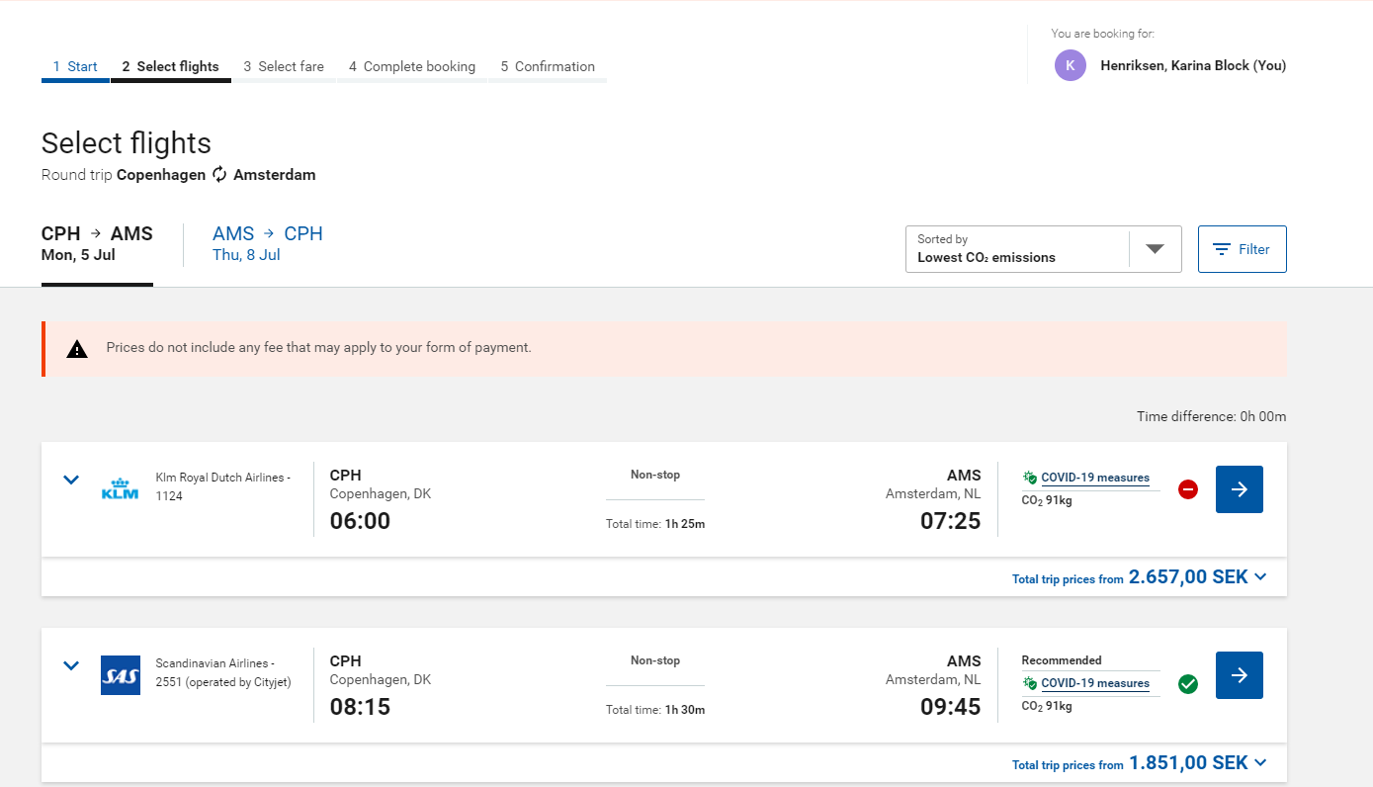
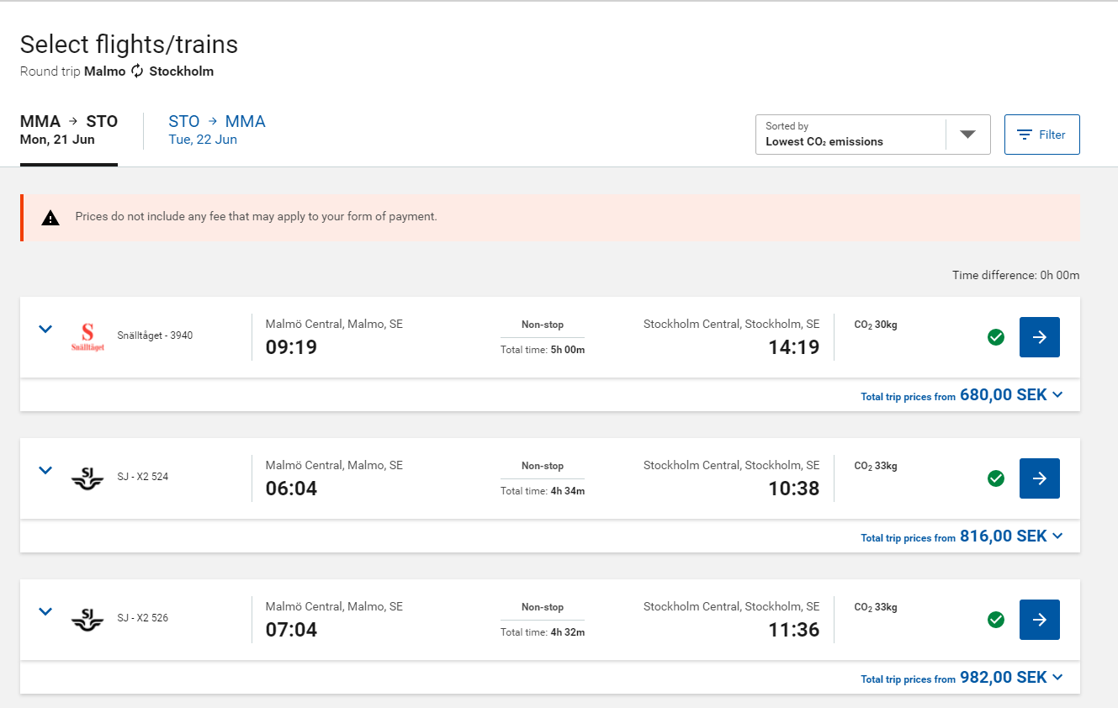
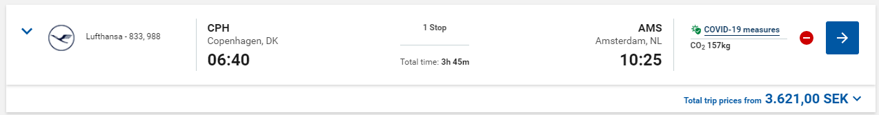
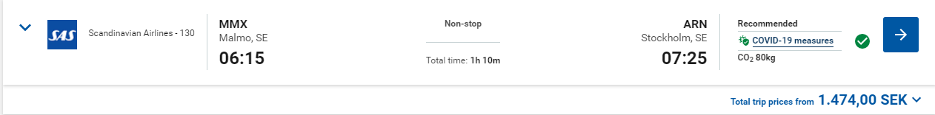
Flights / Rail
How IKEA via the online tool show the CO2 impact of a traveler choice at the time of booking.

Slide 13
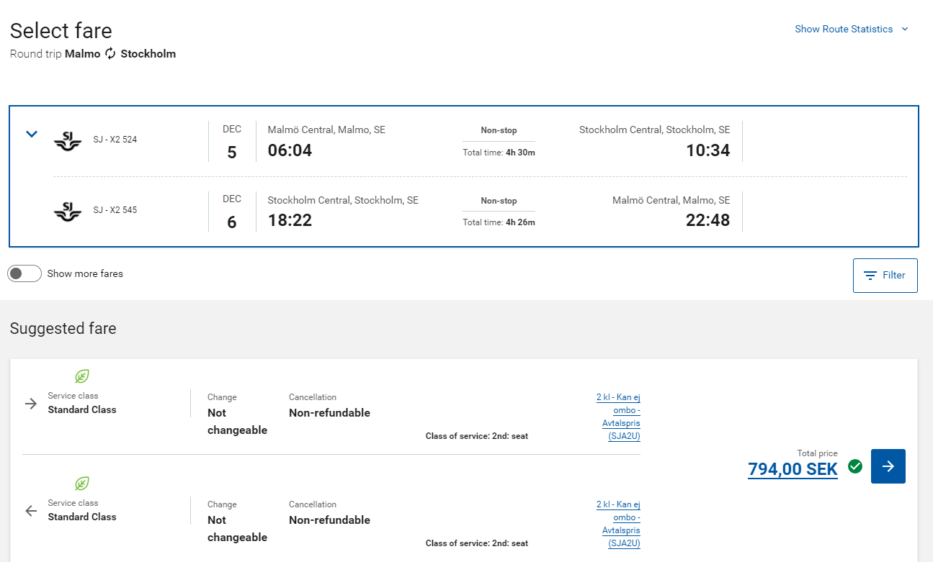
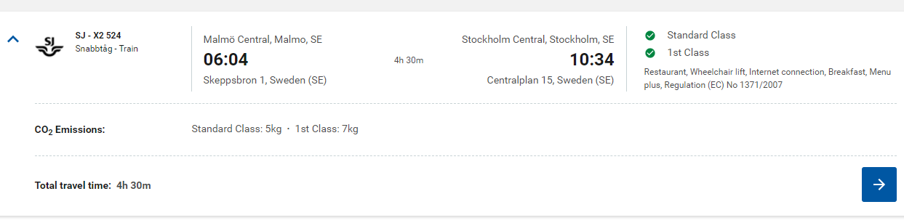

Rail
How IKEA via the online tool show the CO2 impact of a traveler choice at the time of booking.
The green leaf indicate this is a sustainable option according to the IKEA travel program

Slide 14
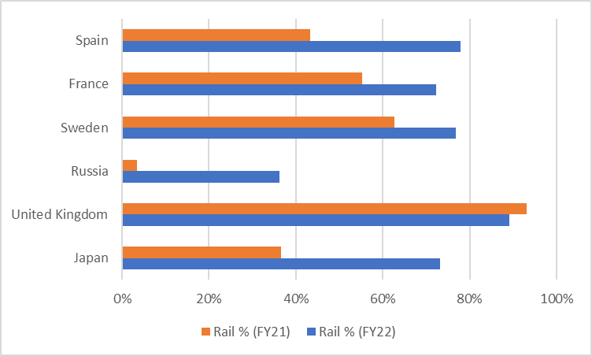
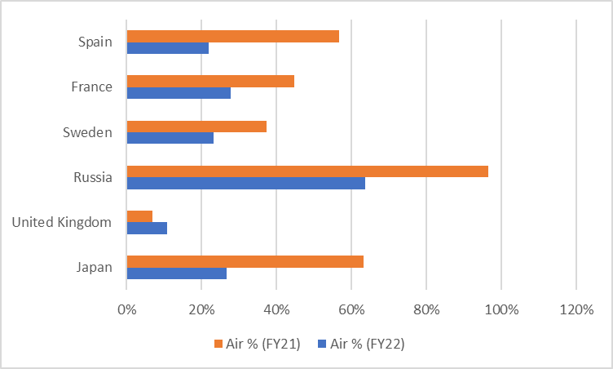
Air vs Rail FY 22 compared to FY21
Increase of rail FY22
Spain 35%
France 17%
Sweden 14%
Russia 33%
Japan 36%

Slide 15
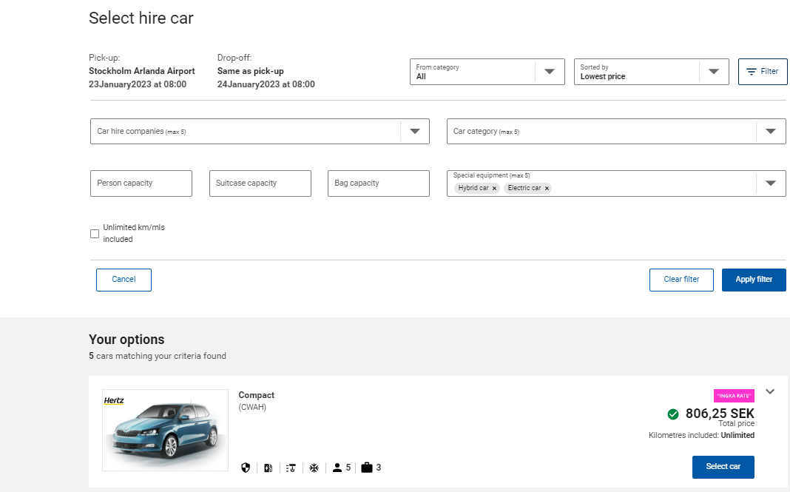
Car rentals
How IKEA via the online tool show the CO2 impact of a traveler choice at the time of booking.

Slide 16

Ongoing Global Sustainable initiatives
Sustainable hotels and CO2 measurements available in our Online tool for Hotel, Car and overall ground Transportation
Push our Travel Agencies and Online booking tools to add more rail content and self-service solutions via the tool
Individual Traveler Karma Dashboard (Cost, CO2, Health & Wellbeing)
Co-worker Commuting
Meeting and Events Sustainable Dashboard

Slide 17
Before you leave
Give us Your Feedback -
It’s in the App!
1- Click on « Schedule »
2- Find and add your session
3- Move to the bottom
4- Take the survey ☺
Join us to continue this conversation!
« Meet the experts »
Re:Imagine area in the Expo
11:15 - 11:45
Table 15

Slide 18
thank you for attending :)

